Slide 1
Module 2: Effective Cleaning Techniques

Slide 2
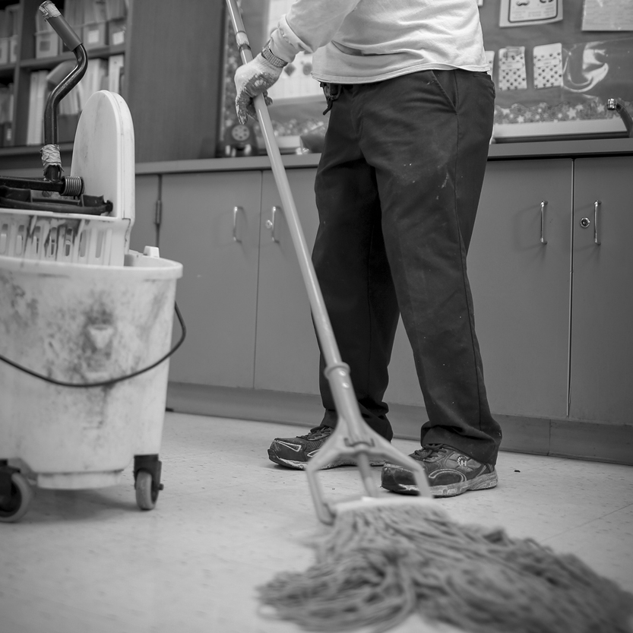
Outline
Lead Dust Traps
Recommended Cleaning Techniques
Helpful Hints
Notes:
Today’s session will be approximately 60 minutes, we will discuss:
Lead Dust Traps
Recommended Cleaning Techniques
Helpful Hints

Slide 3
Outcomes
List three lead dust traps typically found in homes
List three items used to clean lead dust in the home
Demonstrate proper cleaning techniques
Explain how to prevent re-contaminating previously cleaned areas of the home
Notes:
Upon the completion of Module 2, participants will be able to:
List three lead dust traps typically found in homes;
List three items used to clean lead dust in the home;
Demonstrate proper cleaning techniques; and
Explain how to prevent re-contaminating previously cleaned areas of the home.

Slide 4
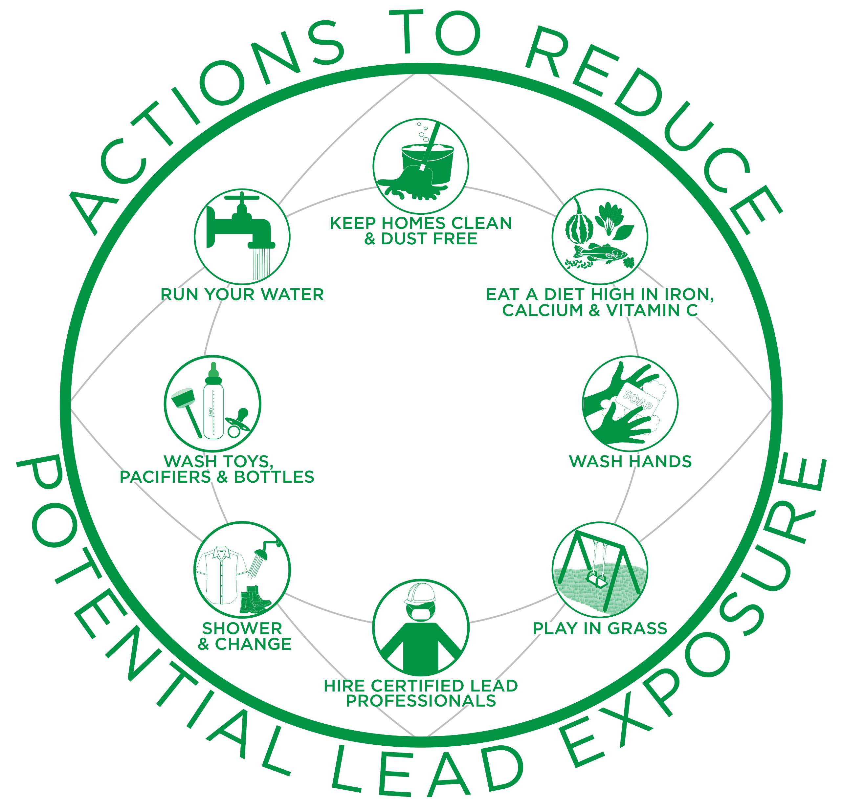
Introduction
In Module 1 we learned about:
  Potential sources of lead exposure
  Health effects and potential impacts
  Actions that can minimize or eliminate potential exposure to lead
Notes:
I. Introduction
In Module 1: Understanding Lead, we learned about potential sources of lead exposure; health effects of lead exposure in children; potential impacts of lead on cultural practices and wildlife; and actions that can minimize or eliminate potential exposure to lead. Examples of these actions include washing children’s hands often and removing shoes before entering your home to avoid tracking in lead from soil, work sites and/or hobbies.

Slide 5
Do you think that cleaning your house using specific cleaning techniques could help reduce potential exposure to lead?
Notes:
Do you think that cleaning your house using specific cleaning techniques could help reduce potential exposure to lead? Instructor Note: Allow participants a moment to think and respond.

Slide 6
YES!
You can reduce your family’s potential exposure to lead in the home by using specific cleaning techniques that allow you to safely remove lead dust and paint chips
Notes:
Yes! You can reduce your family’s potential exposure to lead in the home by using specific cleaning techniques that allow you to safely remove lead dust and paint chips.

Slide 7
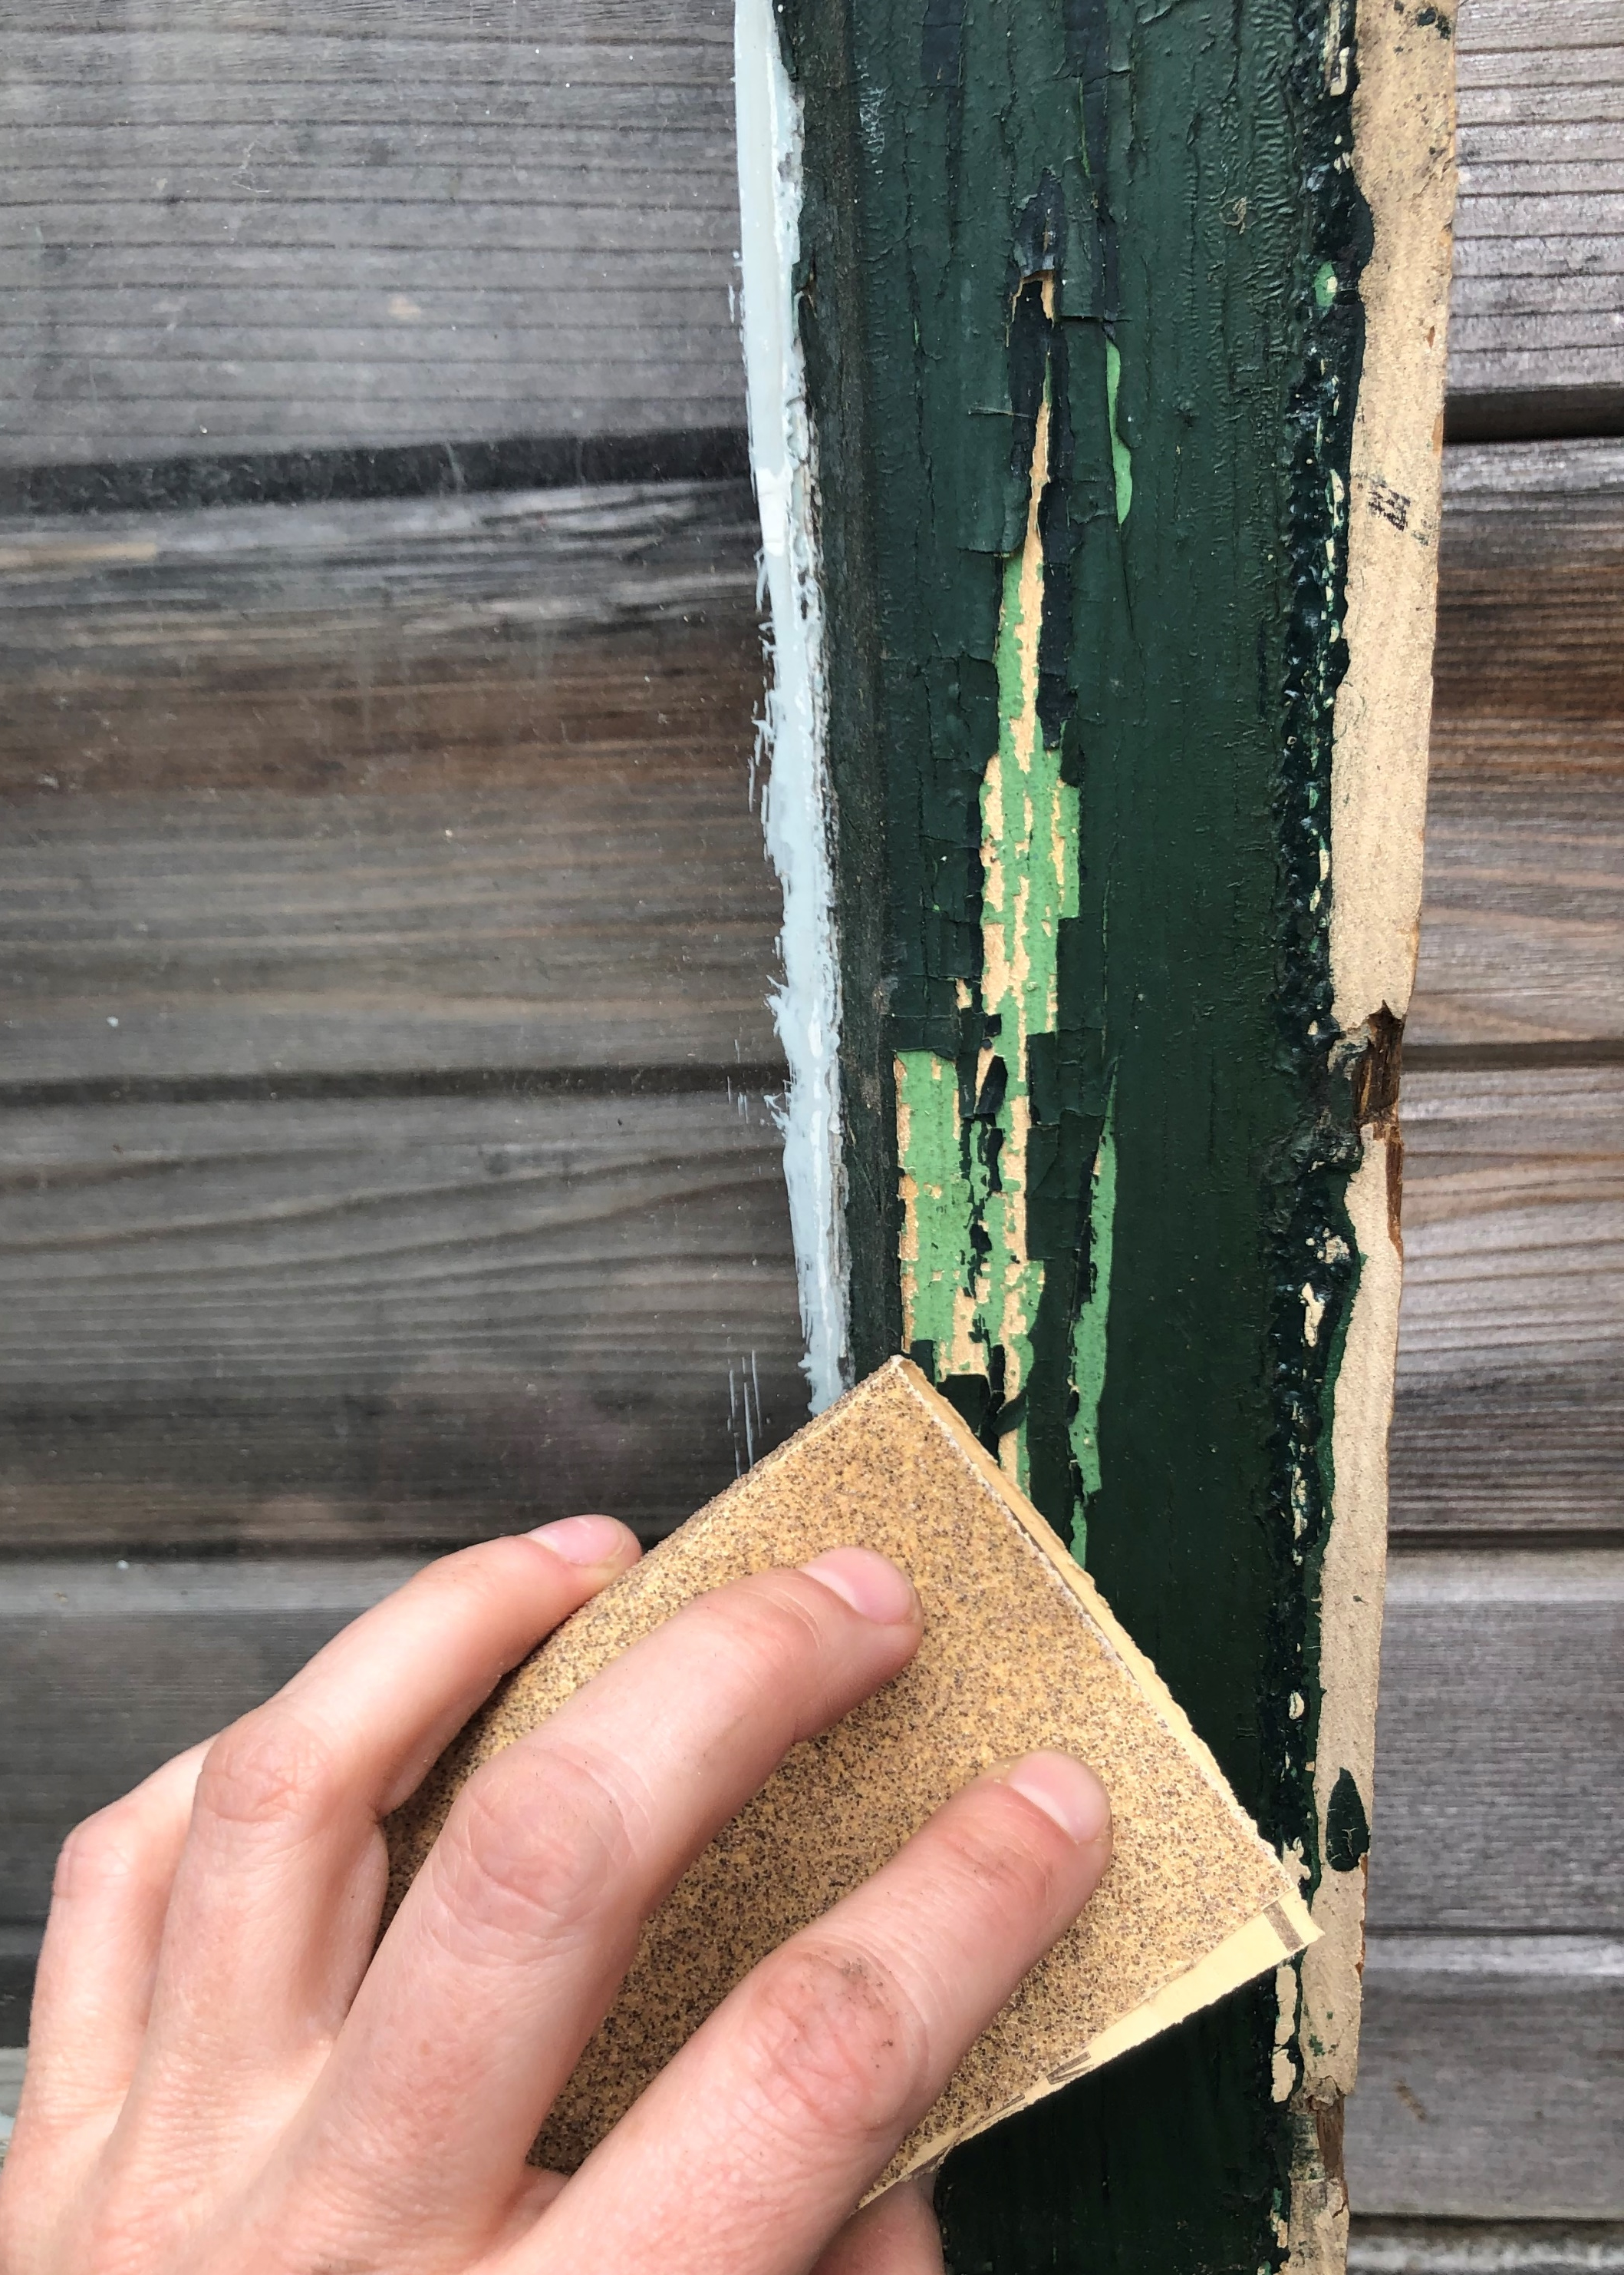
Lead Dust
Forms when lead-based paint is scraped, sanded or heated
Forms when painted surfaces containing lead bump or rub together
Lead dust is household dust that contains lead
Notes:
Lead dust can form when lead-based paint is scraped, sanded or heated. It also forms when painted surfaces containing lead bump or rub together (Ref. 1). For today’s discussion, lead dust is defined as household dust that contains lead.
Today, we will discuss and practice some recommended cleaning techniques for areas in the home where there is peeling, chipping, deteriorating, or cracking lead-based paint and where lead dust is formed.
When areas with lead-based paint or lead dust are not cleaned properly it may increase risks to families, especially to children under age six and pregnant women. Therefore, it is important to use the cleaning methods introduced in this module to reduce your family’s potential exposure to lead.

Slide 8
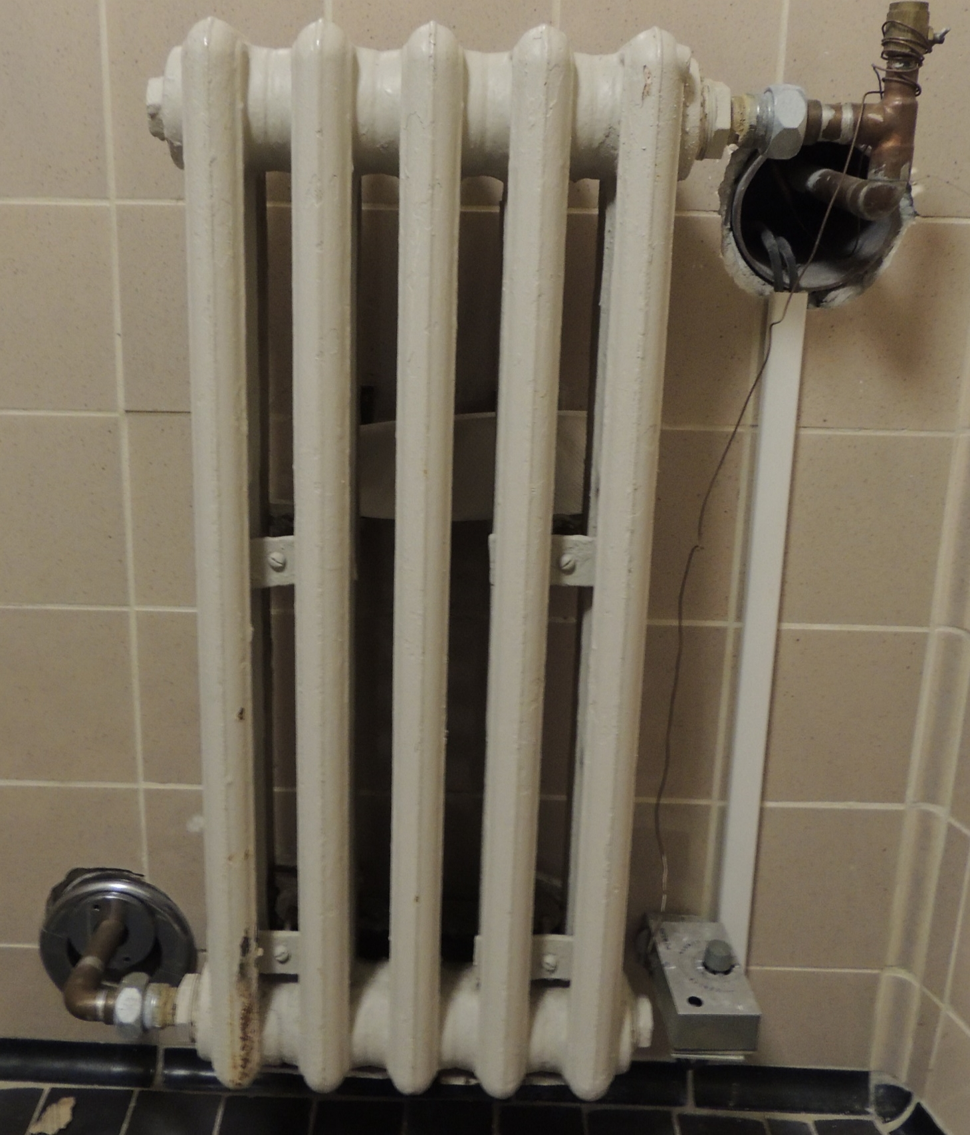
Lead Dust Traps
Space or object where lead dust can easily gather on, in or under
Areas or surfaces in homes that could have lead dust
High-traffic areas
  Living room
  Kitchen
  Bedrooms
Notes:
II. Lead Dust Traps
A lead dust trap is a space or object where lead dust can easily gather on, in or under. Many areas or surfaces in homes could have lead dust. High-traffic areas where you and your family spend most of their time within the home such as the living room, kitchen and bedrooms are common places where dust gathers. Surfaces that receive a lot of wear-and-tear (use) can deteriorate lead-based paint into dust particles and chips over time, causing these areas to be common sources of lead dust.

Slide 9

Children
Tend to play in high-traffic areas
Put their hands, feet or toys into their mouths, which may result in swallowing or breathing in lead dust
May lick or bite chewable lead-based paint surfaces
Photo by Jelleke Vanooteghem on Unsplash
Notes:
Unfortunately, high-traffic areas also tend to be the favorite spots for children to play. Babies and young children often put their hands, feet or toys into their mouths, which may result in swallowing or breathing in lead dust. Lead-based paint has a "sweet" taste, which makes it appealing to young children, so they may also lick or bite chewable lead-based painted surfaces. Children’s hands are small and can fit in tight places that are often missed during cleaning.

Slide 10
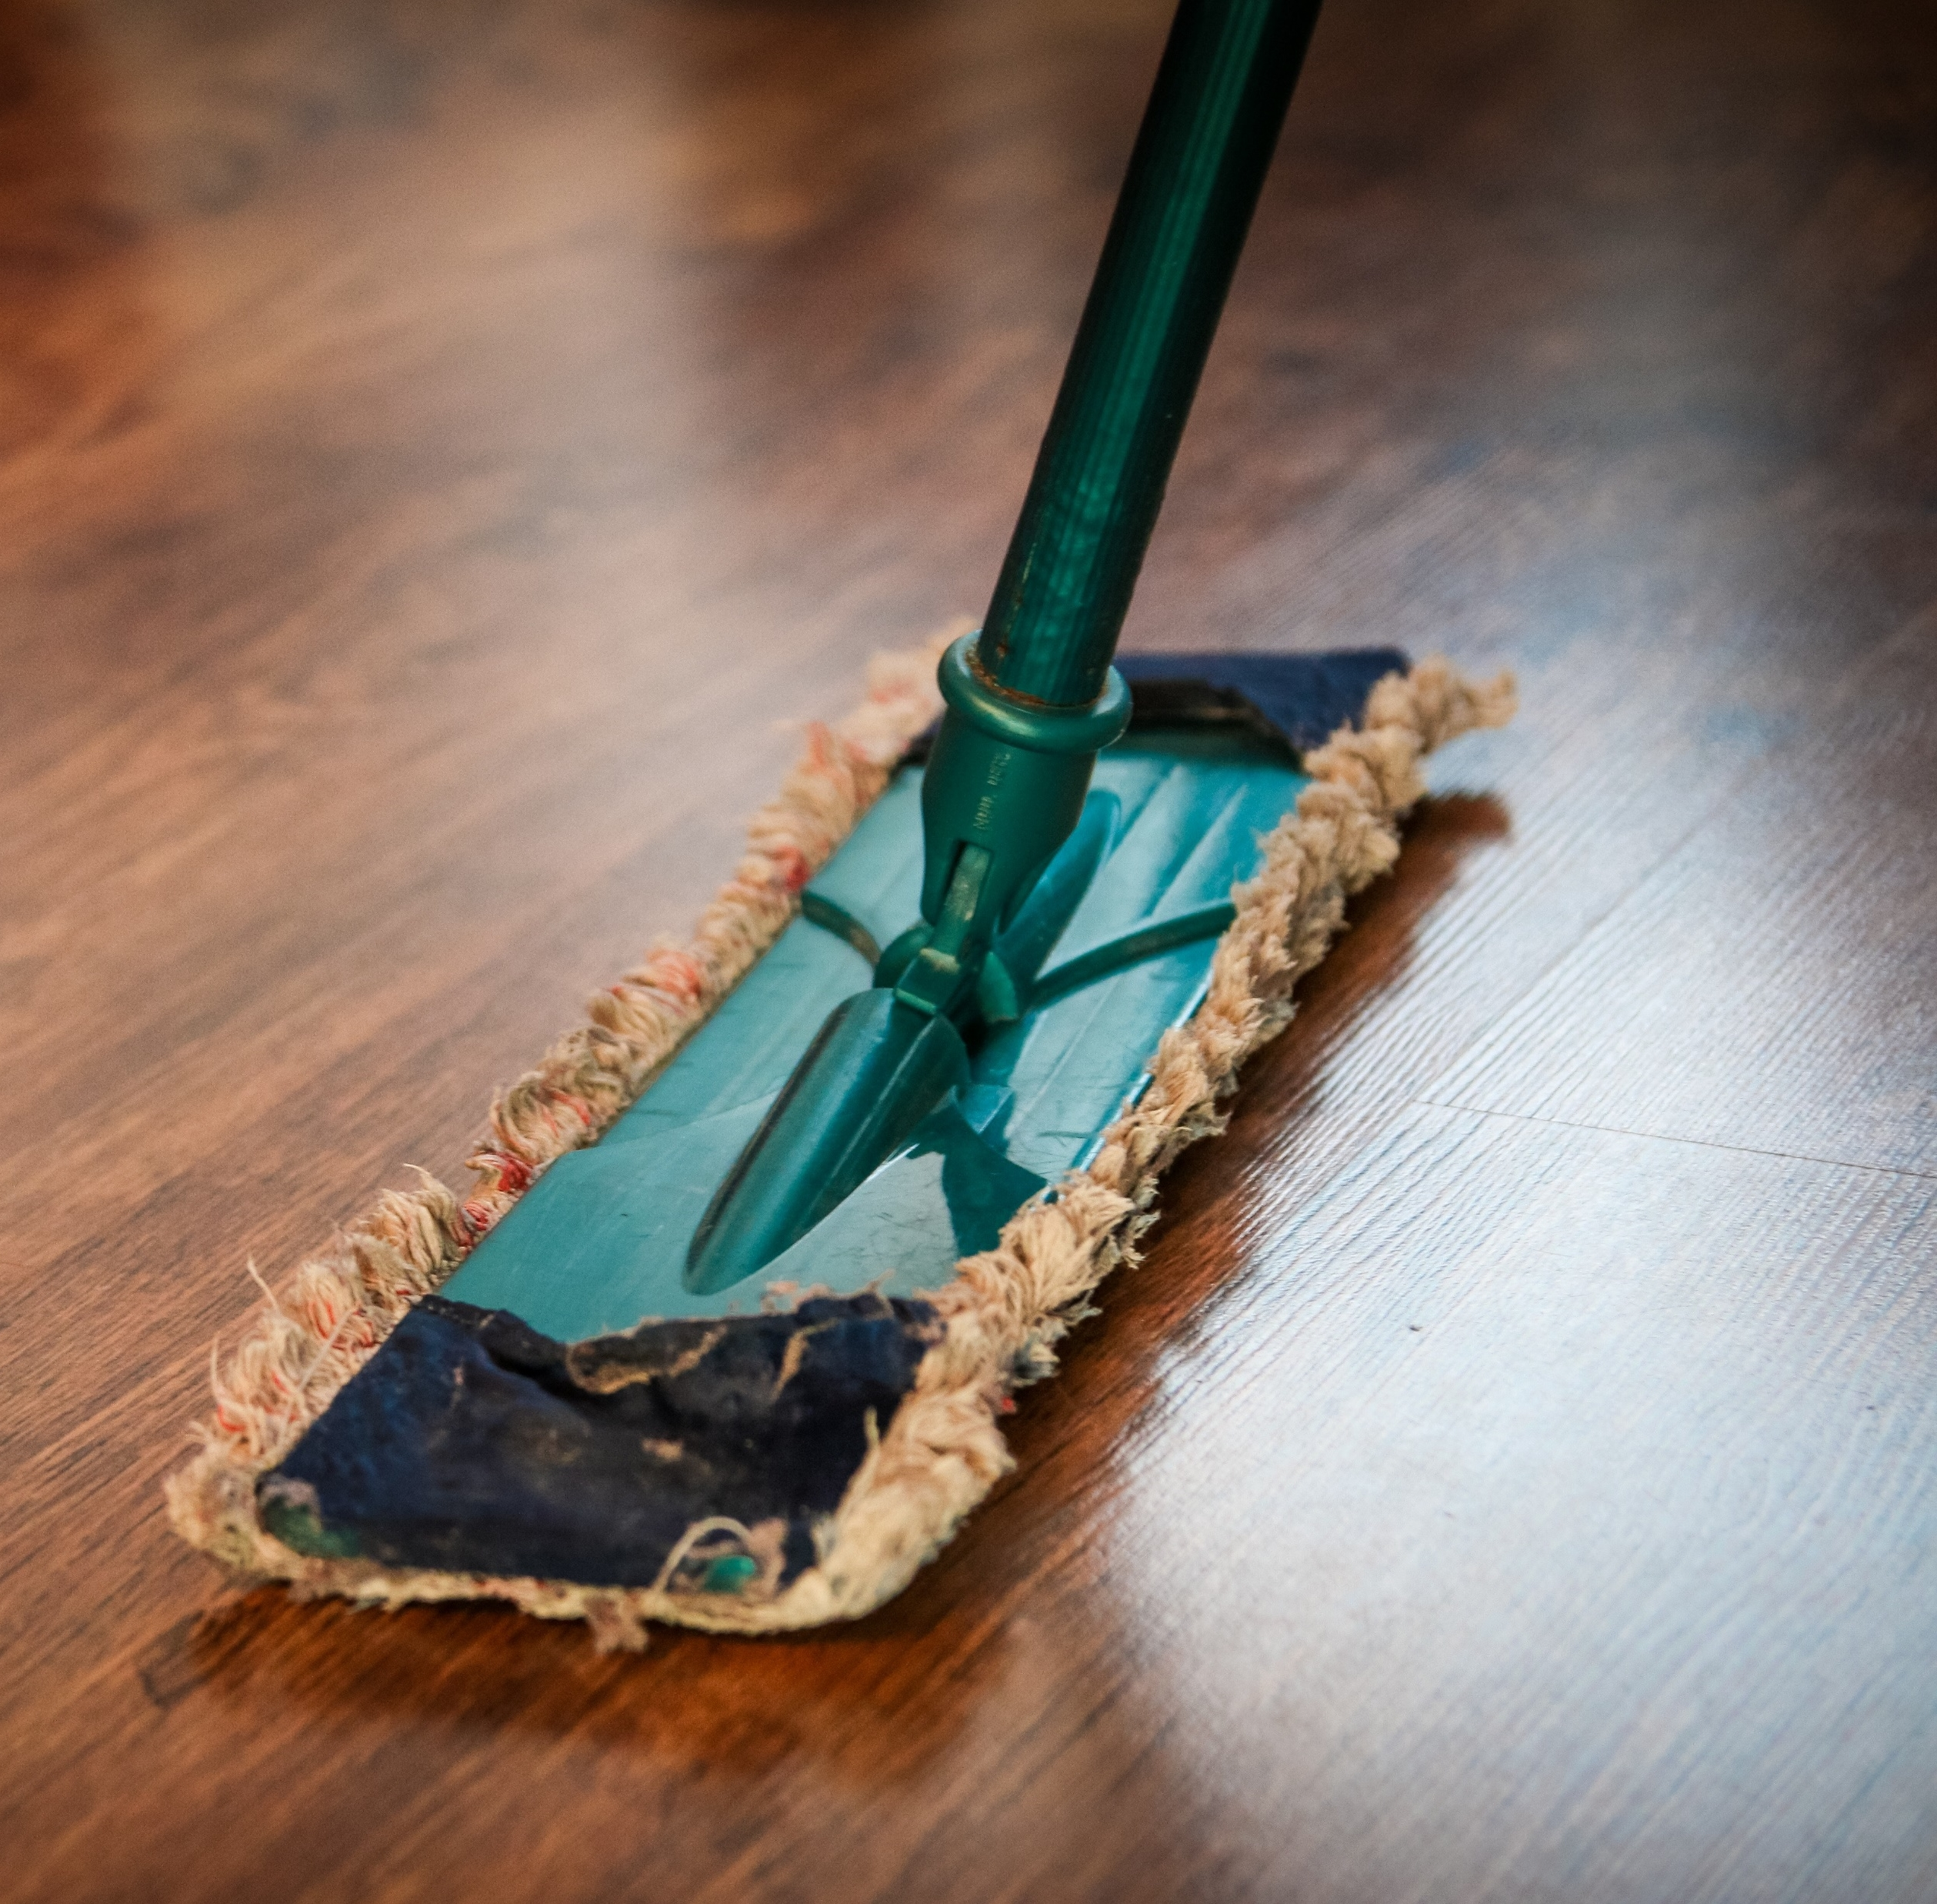
Cleaning
Concentrating cleaning efforts on areas where lead dust is commonly trapped can dramatically reduce potential lead exposure
Lead dust missed during cleaning can easily spread to other areas of the home
Notes:
By concentrating cleaning efforts on areas where lead dust is commonly trapped, potential exposure to lead dust can be dramatically reduced. Any lead dust missed during cleaning or spread by using inappropriate cleaning techniques such as dry sweeping or dusting can easily spread to other areas of the home, including those that have already been cleaned, and then be swallowed or breathed in by children and adults. This means that thorough cleaning using effective techniques is important.
Cleaning is a great way to prevent potential lead exposure.

Slide 11
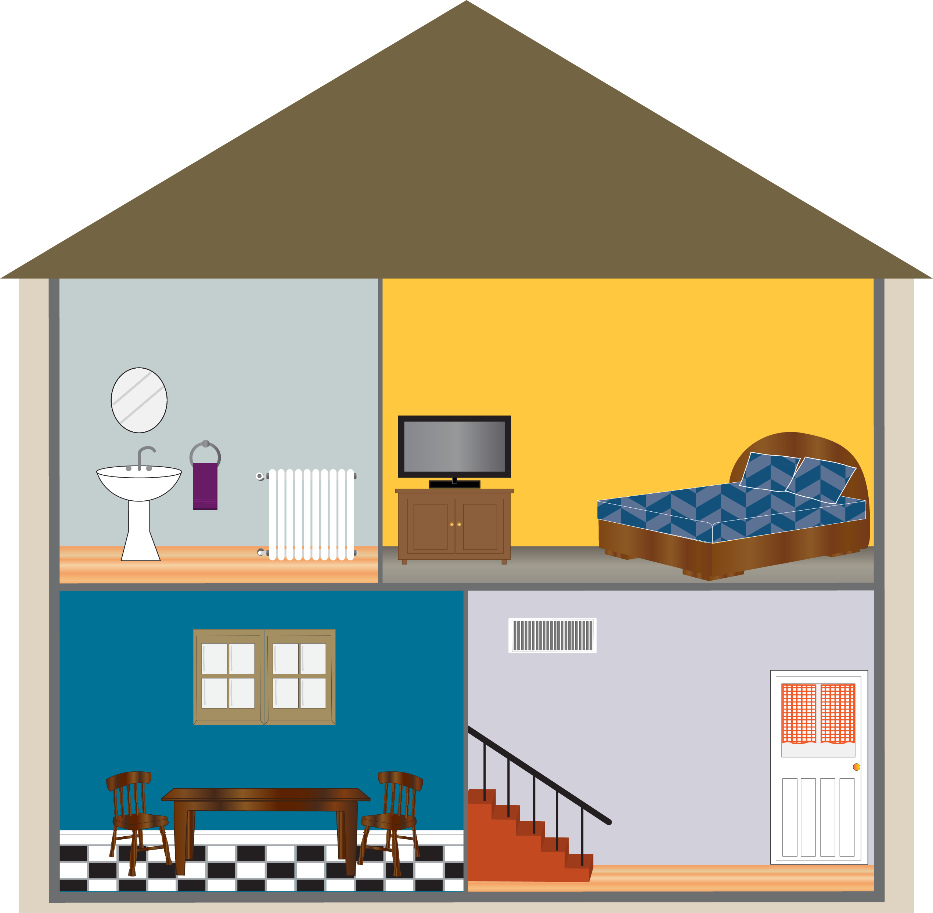
Potential Dust Traps
Notes:
a. Potential Dust Traps
Instructor Note: Give a copy of the Module 2 Worksheet, Module 2 Key Messages and a pencil to each participant.
Here are two handouts we will use today, the worksheet and key messages. We will use the worksheet during this session as a discussion tool and to review what we learned together. The key messages is a take-home resource that summarizes information covered.
What are some areas in the home that could have high levels of lead dust? Using the front of the worksheet, discuss with a partner which areas in the home you think could be lead dust traps. There are six areas in the home considered to be lead dust traps. The home shown in the worksheet has at least six lead dust traps. Find and circle them all. Instructor Note: Allow participants several minutes to complete the activity and then go over the answers below. Answers are provided upside down on the bottom of the front page of the worksheet.

Slide 12
Potential Dust Traps
6. Furniture
3. Air Duct Covers and Radiators
5. Stairs, Railings and Banisters
2. Windows and Window Sills
1. Floors and
Baseboards
4. Doors and Door Frames
Notes:
ANIMATED SLIDE – multiple clicks required (each click will show answers).
As we go over answers, make sure you have the correct items circled on your worksheet. You can also use your worksheet to take notes.
Floors and Baseboards - Lead dust can be dispersed from deteriorated lead-based paint applied on floors and baseboards. Carpets and rugs can contain lead dust dispersed from deteriorated lead-based paint on floors, baseboards and walls.
Windows and Window Sills - Lead-based paint on windows, window sills and troughs (the area between the interior window sill and the storm window frame) can chip or flake as a home ages and after repeatedly opening and closing resulting in lead dust settling on and around windows.
Air Duct Covers and Radiators - The surfaces or covers of air ducts (areas along walls and floors covered by metal grates) and radiators can be covered with dust, although the concentration of lead dust in this area generally is not as high as in other areas of the home.
Doors and Door Frames - Dust from lead-based paint can be dispersed into the air from painted walls, windows and floors and then settle on doors and door frames. Lead from outside sources may also stick to the surface of exterior doors and then be tracked inside the home.
Stairs, Railings and Banisters - Walking on stairs painted with lead-based paint causes the paint to flake and chip, which disperses lead dust on stairs, railings and banisters.
Furniture - Lead dust dispersed into the air can settle and collect on furniture, such as tables and couches, and then re-enter the air when you vacuum, dust or sweep.
Excessive clutter may prevent you from effectively cleaning your home as various items in your home could be potential lead dust traps.

Slide 13
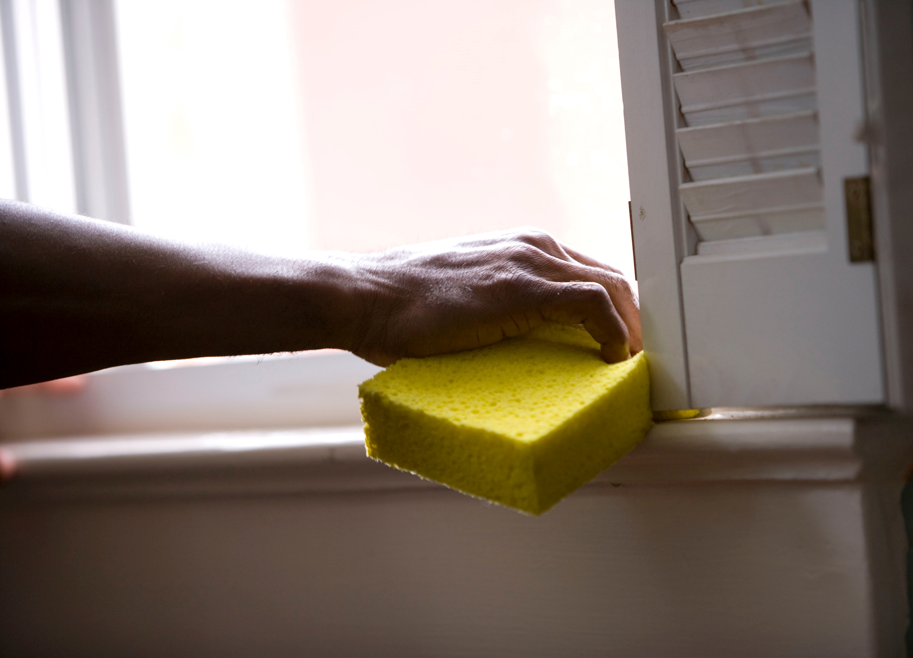
Recommended Cleaning Techniques
Clean lead dust traps weekly
Windows, doors, floors and furniture need regular cleaning
Lead dust is hard to remove
Lead dust re-collects quickly
Photo by CDC on Unsplash
Notes:
II. Recommended Cleaning Techniques
Cleaning lead dust traps weekly can reduce your family’s exposure to lead. Windows, doors, floors, and furniture need regular cleaning because lead dust is hard to completely remove and can quickly re-collect.

Slide 14
What specific cleaning techniques do you think might be important to incorporate into our cleaning habits to help safely remove lead dust from the home?
Notes:
What specific cleaning techniques do you think might be important to incorporate into our cleaning habits to help safely remove lead dust from the home? Instructor Note: Allow participants a moment to think and respond before describing the recommended techniques. While it is recommended to have two buckets for wet washing, it is not required.

Slide 15
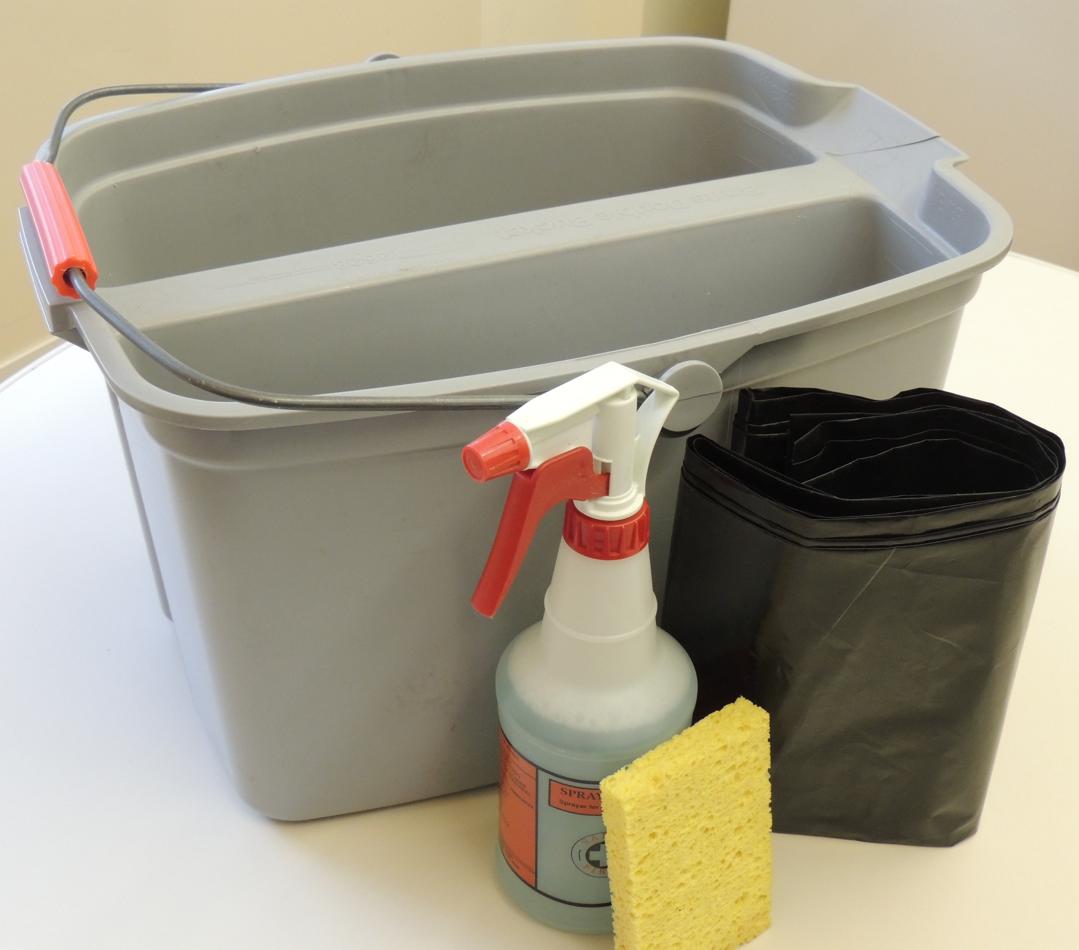
Wet Washing
Using wet or damp items is the best way to clean up lead dust
  Mop, cloth or sponge
  Warm water
  General all-purpose cleaner
  Two buckets or a split bucket
Notes:
Wet washing, using wet or damp items, is the best way to clean lead dust. Specifically, in the case of lead dust, this means cleaning areas at least weekly with a mop, cloth or sponge, warm water and a general all-purpose cleaner, using two buckets (or a split bucket, if available). Two buckets assist in preventing dust from being redistributed to newly cleaned surfaces. Areas that should be wet washed include windows, window sills and troughs, doors, floors, stairs, furniture and air ducts. Remember: Never mix ammonia and bleach products because they can form a dangerous gas. Follow instructions on the label of all cleaning products used and keep cleaning products out of the reach of children.

Slide 16
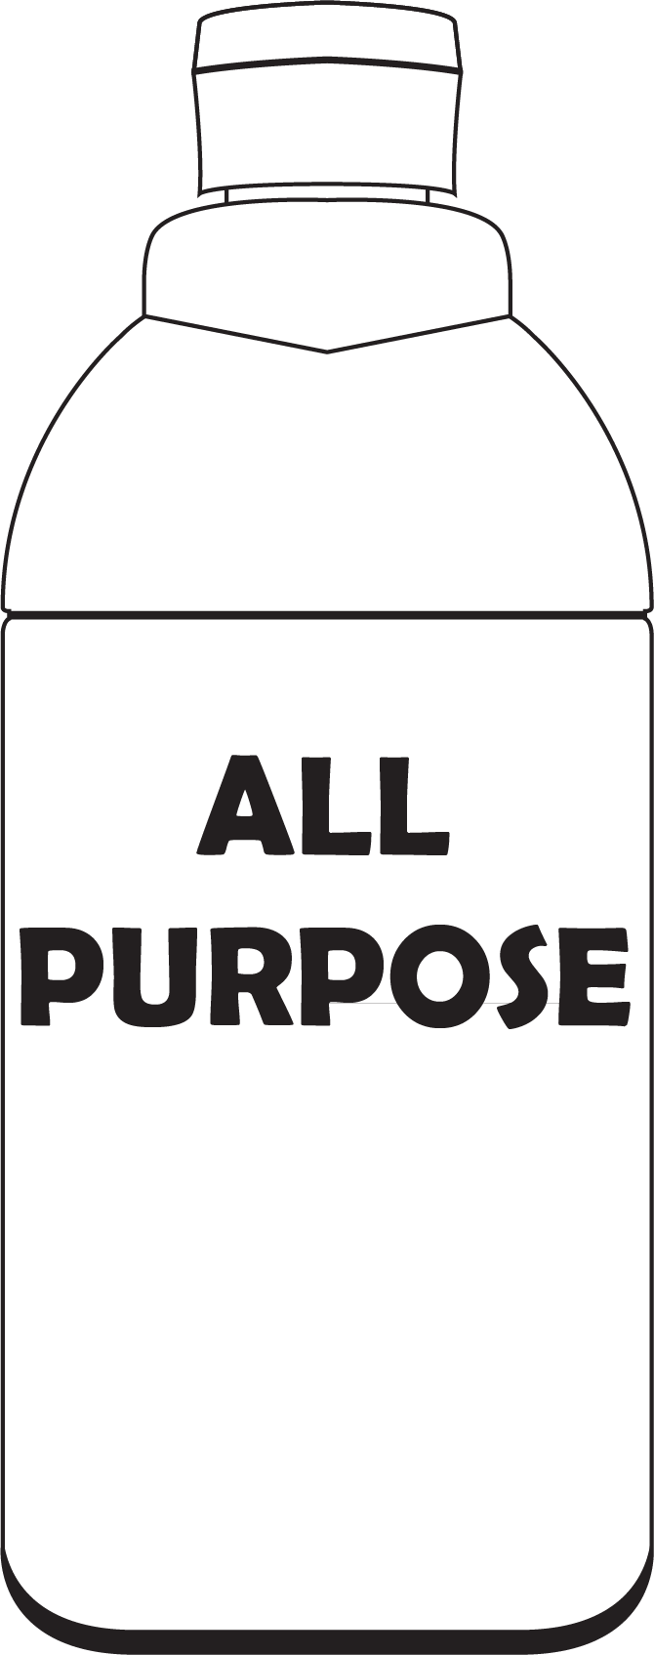




Wet Washing Steps
Follow these steps:
In bucket 1, mix general all-purpose cleaner and warm water
Fill bucket 2 with warm water – this will be your clean rinse water to frequently rinse off mop heads, cloths and sponges while cleaning
Put on gloves
Notes:
Follow these steps for wet washing when cleaning:
In bucket 1, mix general all-purpose cleaner and warm water.
Fill bucket 2 with warm water – this will be your clean rinse water to frequently rinse off mop heads, cloths and sponges while cleaning.
Put on gloves.

Slide 17
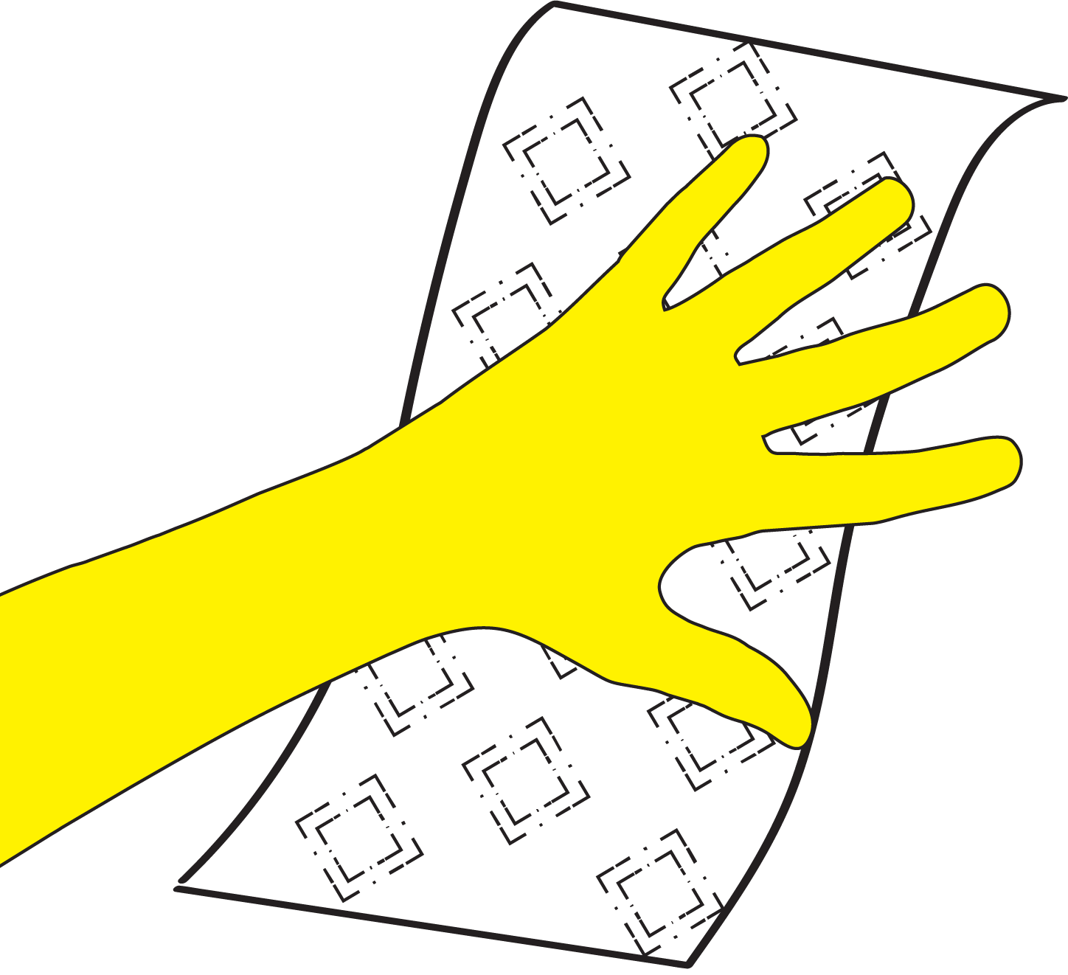
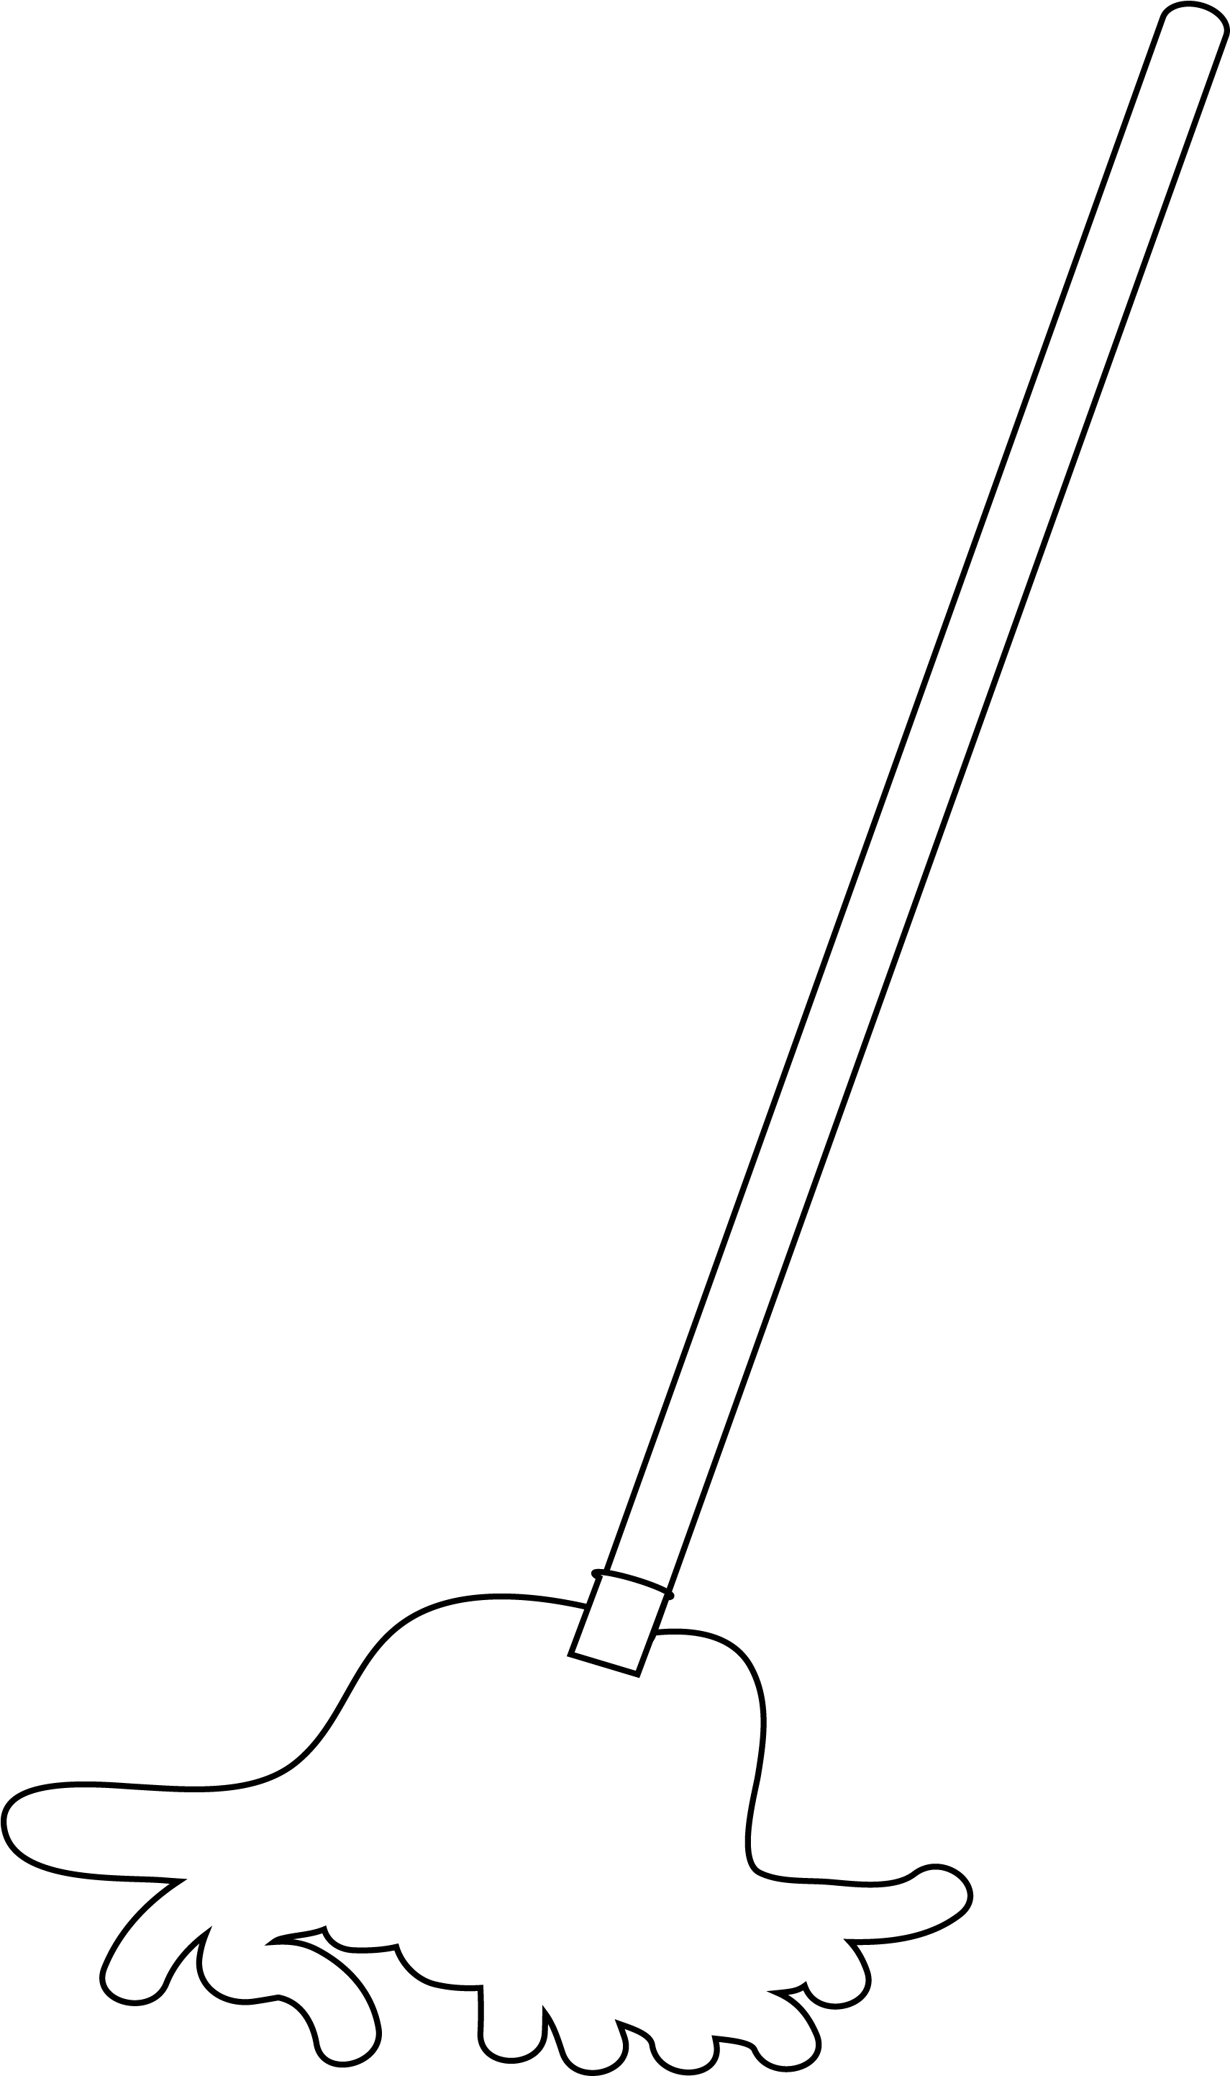

Wet Washing Steps
Use a damp paper towel to remove any loose paint chips and debris and then place paper towel in a garbage bag and seal for disposal
Use a cloth, sponge or mop dipped in bucket 1 (the cleaning solution) and clean all surfaces thoroughly
Using a cloth, sponge or mop that has been dipped in bucket 2 (the clean rinse water) to rinse the newly cleaned area
Notes:
Use a damp paper towel to remove any loose paint chips and debris and then place the paper towel in a garbage bag and seal for disposal.
Use a mop, cloth or sponge dipped in bucket 1 (the cleaning solution) and clean all surfaces thoroughly.
Use a clean (different) mop, cloth or sponge that has been dipped in bucket 2 (the clean rinse water) to rinse the newly cleaned area.

Slide 18
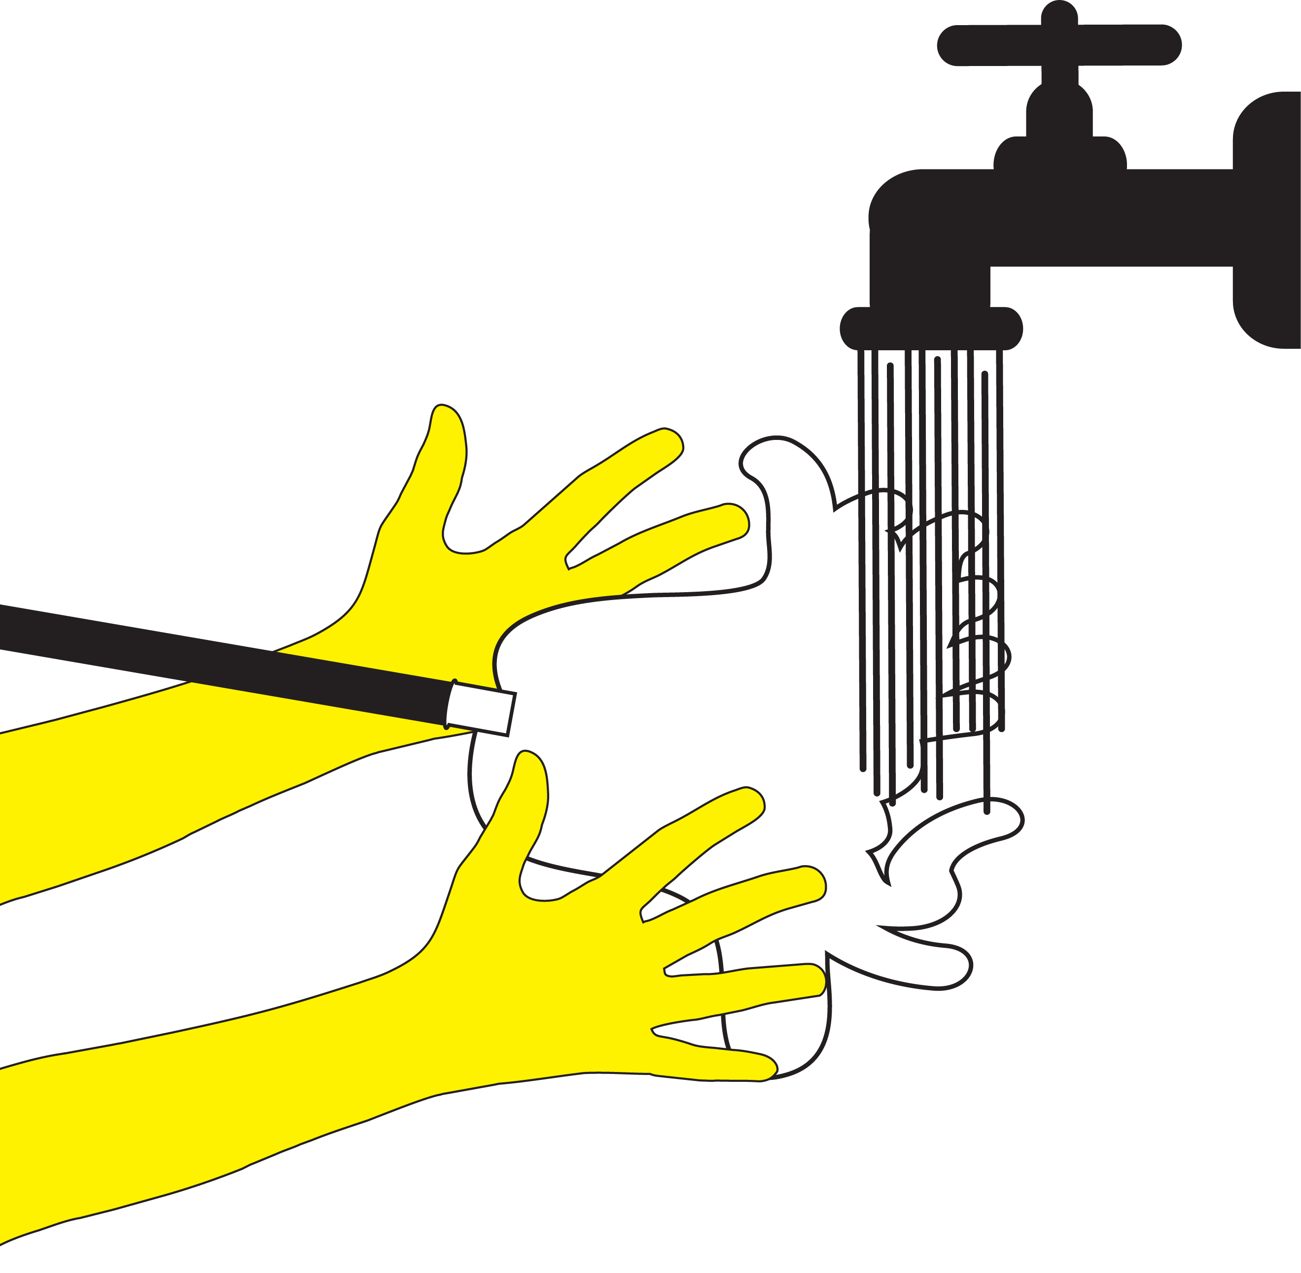
Wet Washing
Thoroughly rinse mop heads, cloths and sponges (preferably in a sink or area not used for food preparation) when finished cleaning
Notes:
Thoroughly rinse mop heads, cloths and sponges (preferably in a sink or area not used for food preparation) when finished cleaning.

Slide 19
Optional Demonstration
Demonstrate the benefits of wet washing by using corn starch of flour to represent lead dust
Which cleaning technique (wet or dry) did the best job of cleaning up the dust?
Notes:
Optional Demonstration
Demonstrate the benefits of wet washing by using corn starch or flour to represent lead dust:
Gather participants around a flat, hard surface, such as a table or a spot on the floor, and sprinkle corn starch or flour across the surface.
Divide the area in half. Clean one-half with a dry cloth and the other half with a wet cloth dipped in bucket 1 (as described in step 1 of wet washing).
Show participants both cloths and have them examine the cleaned area. Ask participants: which cleaning technique (wet or dry) did the best job of cleaning up the dust? Instructor Note: The answer is the technique using the wet cloth.

Slide 20
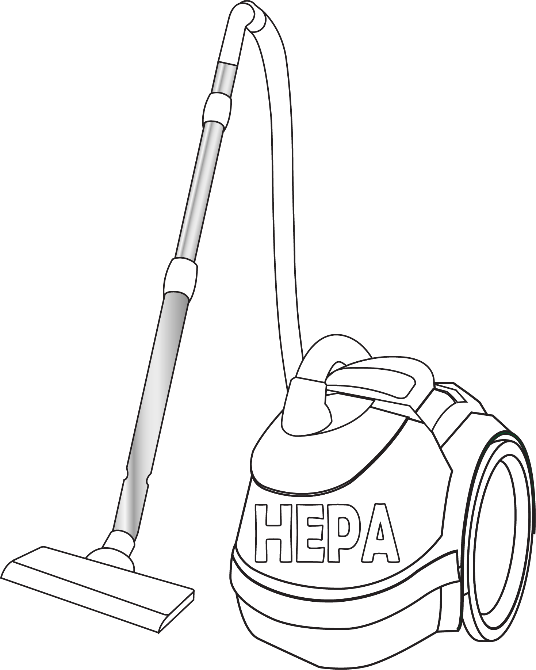


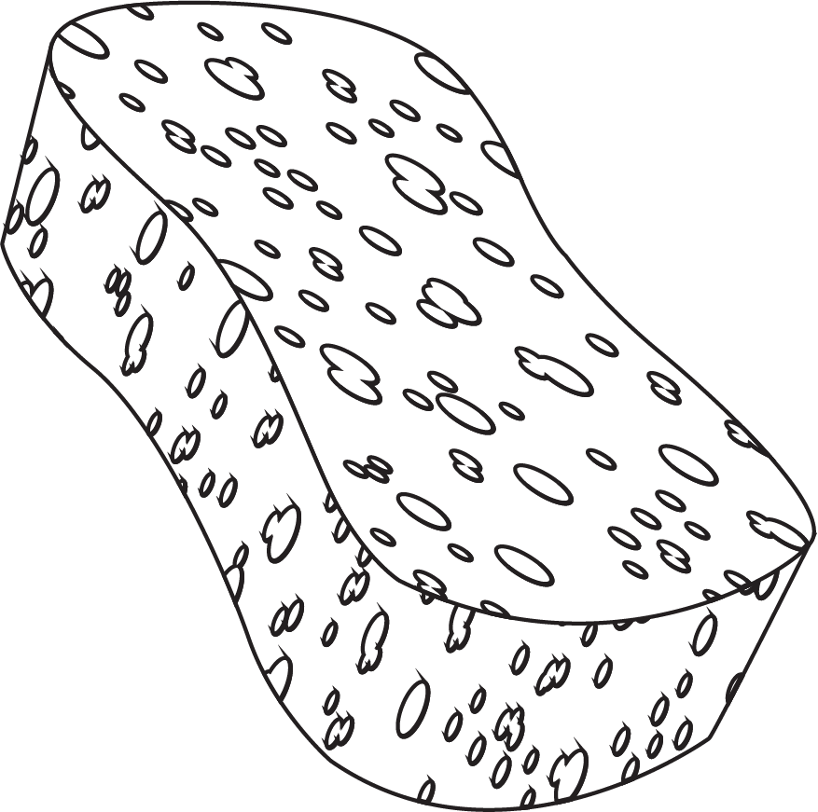
Cleaning Techniques to Reduce Lead Dust
Wet washing is the general cleaning technique recommended to reduce indoor lead dust
Each of the six lead dust traps have specific cleaning recommendations
Notes:
a. Cleaning Techniques to Reduce Indoor Lead Dust
Wet washing is the general cleaning technique recommended to reduce indoor lead dust in your home. For each of the six lead dust traps mentioned earlier (and listed on your Worksheet) there are specific cleaning recommendations we will discuss now.

Slide 21

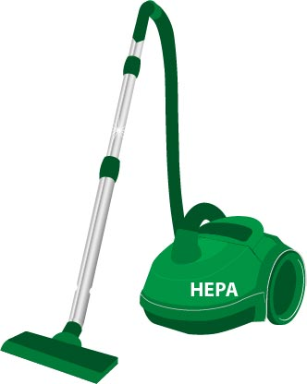
Floors, Baseboards, Carpets and Rugs
Clean floors and baseboards with a clean wet mop, cloth or sponge and a general all-purpose cleaner
Vacuum carpets and rugs using a vacuum with a High Efficiency Particulate Air (HEPA) filter
Notes:
i. Floors, Baseboards, Carpets and Rugs
Clean floors and baseboards with a clean wet mop, cloth or sponge and a general all-purpose cleaner. Vacuum carpets and rugs often using a vacuum cleaner equipped with a High Efficiency Particulate Air (HEPA) filter, which traps extremely small particles such as lead dust. Regular vacuum cleaners not equipped with a HEPA filter can spread lead dust into the air and disperse it around the home.

Slide 22

Floors, Baseboards, Carpets and Rugs
DO NOT:
Use mops with a scrubber strip
Use powered buffing or polishing machines, or vacuums with beater bars
Dry sweep
Shake or beat carpets and rugs (vacuum them instead)
Notes:
Do not use mops with a scrubber strip attached when cleaning uncarpeted floors, as the scrubber strips will wear away any painted surfaces.
Do not use powered buffing or polishing machines, or vacuums with beater bars that may wear away the painted surface of uncarpeted floors.
Do not dry sweep.
Do not shake or beat carpets and rugs, vacuum them instead.

Slide 23
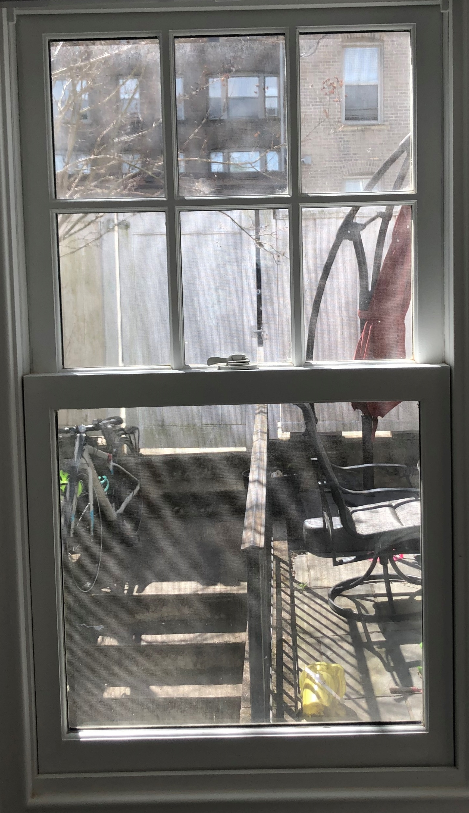
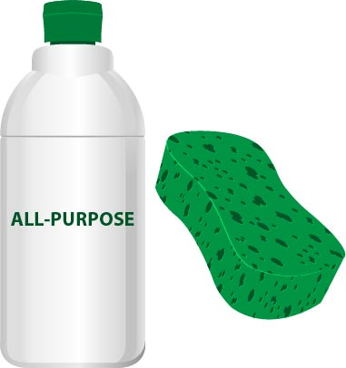
Windows and Window Sills
Clean with a damp cloth or sponge and a general all-purpose cleaner
Notes:
ii. Windows and Window Sills
Clean windows, window sills and troughs with a damp cloth or sponge and a general all-purpose cleaner. Window sills and troughs with large amounts of dust may require using a vacuum cleaner equipped with a HEPA filter. After vacuuming, follow up by cleaning with a damp cloth or sponge and a general all-purpose cleaner. Standard vacuum cleaners may be used if there is no visible dust or debris from chipping or flaking paint (Ref. 3).

Slide 24
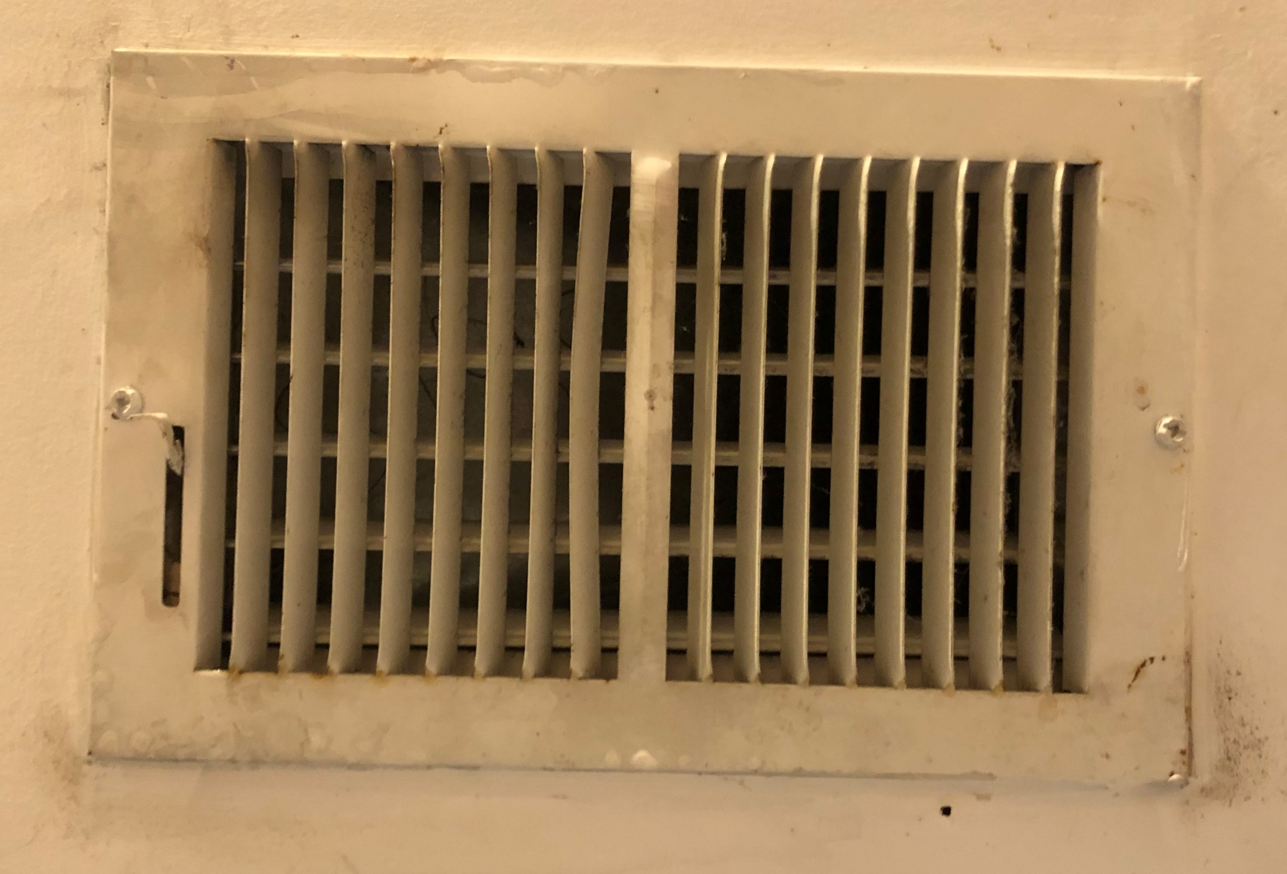
Air Duct Covers and Radiators
Clean with a wet cloth or sponge and a general all-purpose cleaner
Air duct cover (grill)
Notes:
iii. Air Duct Covers and Radiators
Clean the surface of air duct covers (areas along walls and floors covered by metal grates) and radiators monthly using a clean wet cloth or sponge and a general all-purpose. Frequently replace all air filters (including HEPA filters) in the furnace or heating, ventilation and air conditioning (HVAC) system .

Slide 25
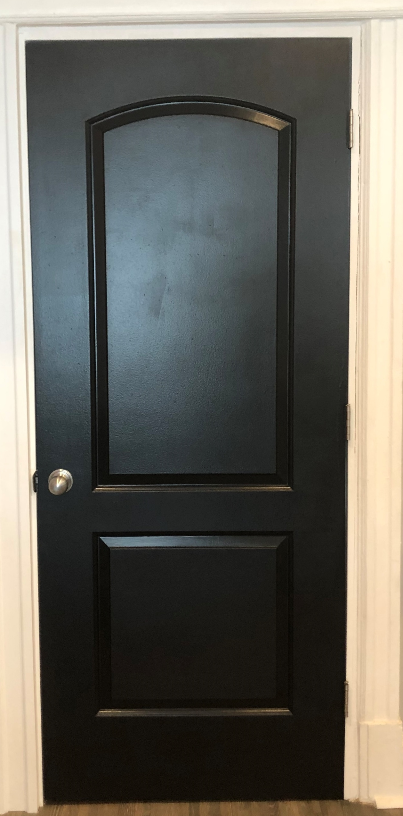
Doors, Door Frames, Walls and Other Painted Surfaces
Wipe down with a clean, wet cloth or sponge and a general all-purpose cleaner
Notes:
iv. Doors, Door Frames, Walls and Other Painted Surfaces
Wipe down doors, door frames, walls and other painted surfaces with a clean, wet cloth or sponge and a general all-purpose cleaner.

Slide 26
Doors, Door Frames, Walls and Other Painted Surfaces
DO NOT:
Use steel wool, scouring pad and abrasive cleaners
Use solvent cleaner that may dissolve paint
Excessively rub spots
Notes:
Do not use:
Steel wool, scouring pads and abrasive cleaners;
Solvent cleaners that may dissolve paint; or
Excessive rubbing of spots, as this may wear away any painted surfaces.

Slide 27
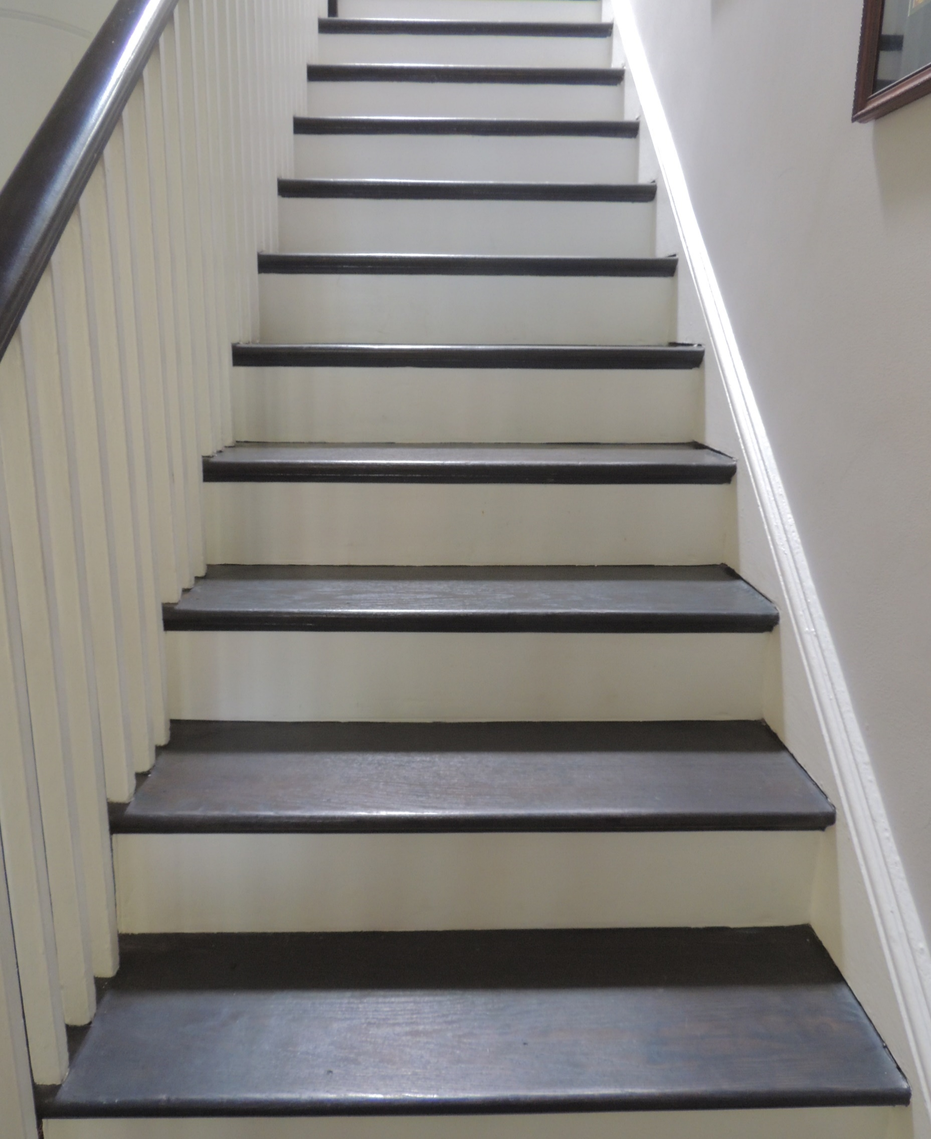
Stairs, Railings and Banisters
Clean with a wet mop, cloth or sponge and a general all-purpose cleaner
Notes:
v. Stairs, Railings and Banisters
Clean stairs, railings and banisters with a wet mop, cloth, or sponge and a general all-purpose cleaner.

Slide 28
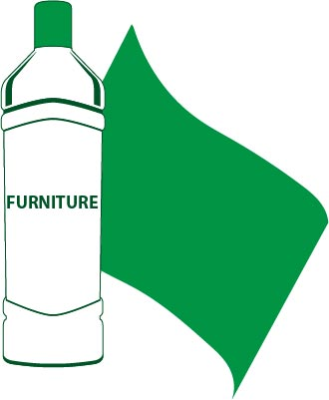
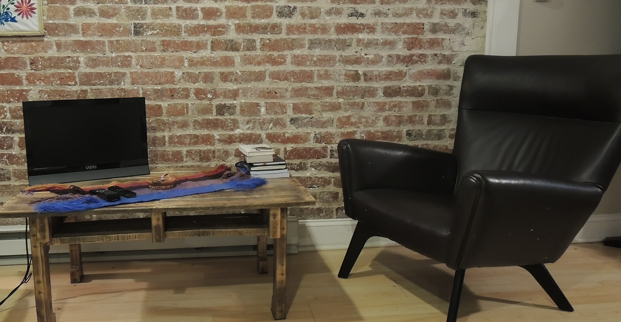
Furniture
Dust with furniture polish to prevent spread of dust into the air
Notes:
vi. Furniture
Dust furniture weekly with furniture polish to prevent the spread of dust into the air. Upholstered furniture, such as couches, do not generally have high concentrations of lead dust that other surfaces do; however, regular cleaning with a HEPA vacuum or a wet washing method is recommended.

Slide 29
Group Activity: Lead Dust Clean-Up
As a group, let’s practice what we learned
Notes:
b. Group Activity: Lead Dust Clean-Up
Now that we have discussed the recommended way to clean lead dust, it is your turn to practice what you have just learned. As a group we are going to clean this room as if we think it has lead dust. Instructor Note: Break participants into four groups, assigning each group specific steps in the wet washing process discussed earlier.
Group one will start by preparing the cleaning solution in bucket one and filling bucket two with clean rinse water;
Group two will then collect any visible loose “chips and dust” using damp paper towels, placing them in a garbage bag and sealing for disposal;
Group three will then mop or wipe up the area using a damp mop, cloth or sponge dipped in bucket one; and
Group four will finish by rinsing the area using a different damp mop, cloth or sponge dipped in bucket two.
Encourage participants to pay attention to other groups. As participants clean, check techniques and answer questions.

Slide 30
Group Activity: Lead Dust Clean-Up
How similar are these techniques to how you already clean your home?
What might be hard about changing your cleaning techniques and habits?
What wet washing step did we skip during the group activity?
Notes:
What are your initial thoughts after practicing the recommended cleaning techniques for reducing lead dust? Instructor Note: Allow participants time to think and respond. Then ask the questions below:
How similar are these techniques to how you already clean your home?
What might be hard about changing your cleaning techniques and habits?
What wet washing step did we skip during the group activity? Instructor Note: We skipped the last step of thoroughly rinsing mop heads, cloths and sponges, since we were not actually cleaning up lead dust, just items that represented lead dust.

Slide 31
What should we do to avoid re-contaminating the area?
Notes:
IV. Helpful Hints
Imagine that you have just finished cleaning your home using the techniques we just discussed and practiced. What should we do to avoid re-contaminating the area? Instructor Note: Allow participants time to think and respond, and then share the information below.

Slide 32

We Should:
Wash hands and cleaning supplies in a sink not used for food preparation
Wash the sink after washing cleaning supplies
Wipe off shoes
Wash clothes and shoes separately
Shower and wash hair
Notes:
We should:
Wash hands and cleaning supplies in a sink (or area) that preferably is not used for food preparation.
Wash the sink itself after washing your cleaning supplies, so that lead dust does not remain in the sink.
Wipe off your shoes after cleaning to avoid tracking dust around your home.
Wash clothes and shoes worn while cleaning separately from other laundry.
Shower and wash hair when you finish cleaning.

Slide 33
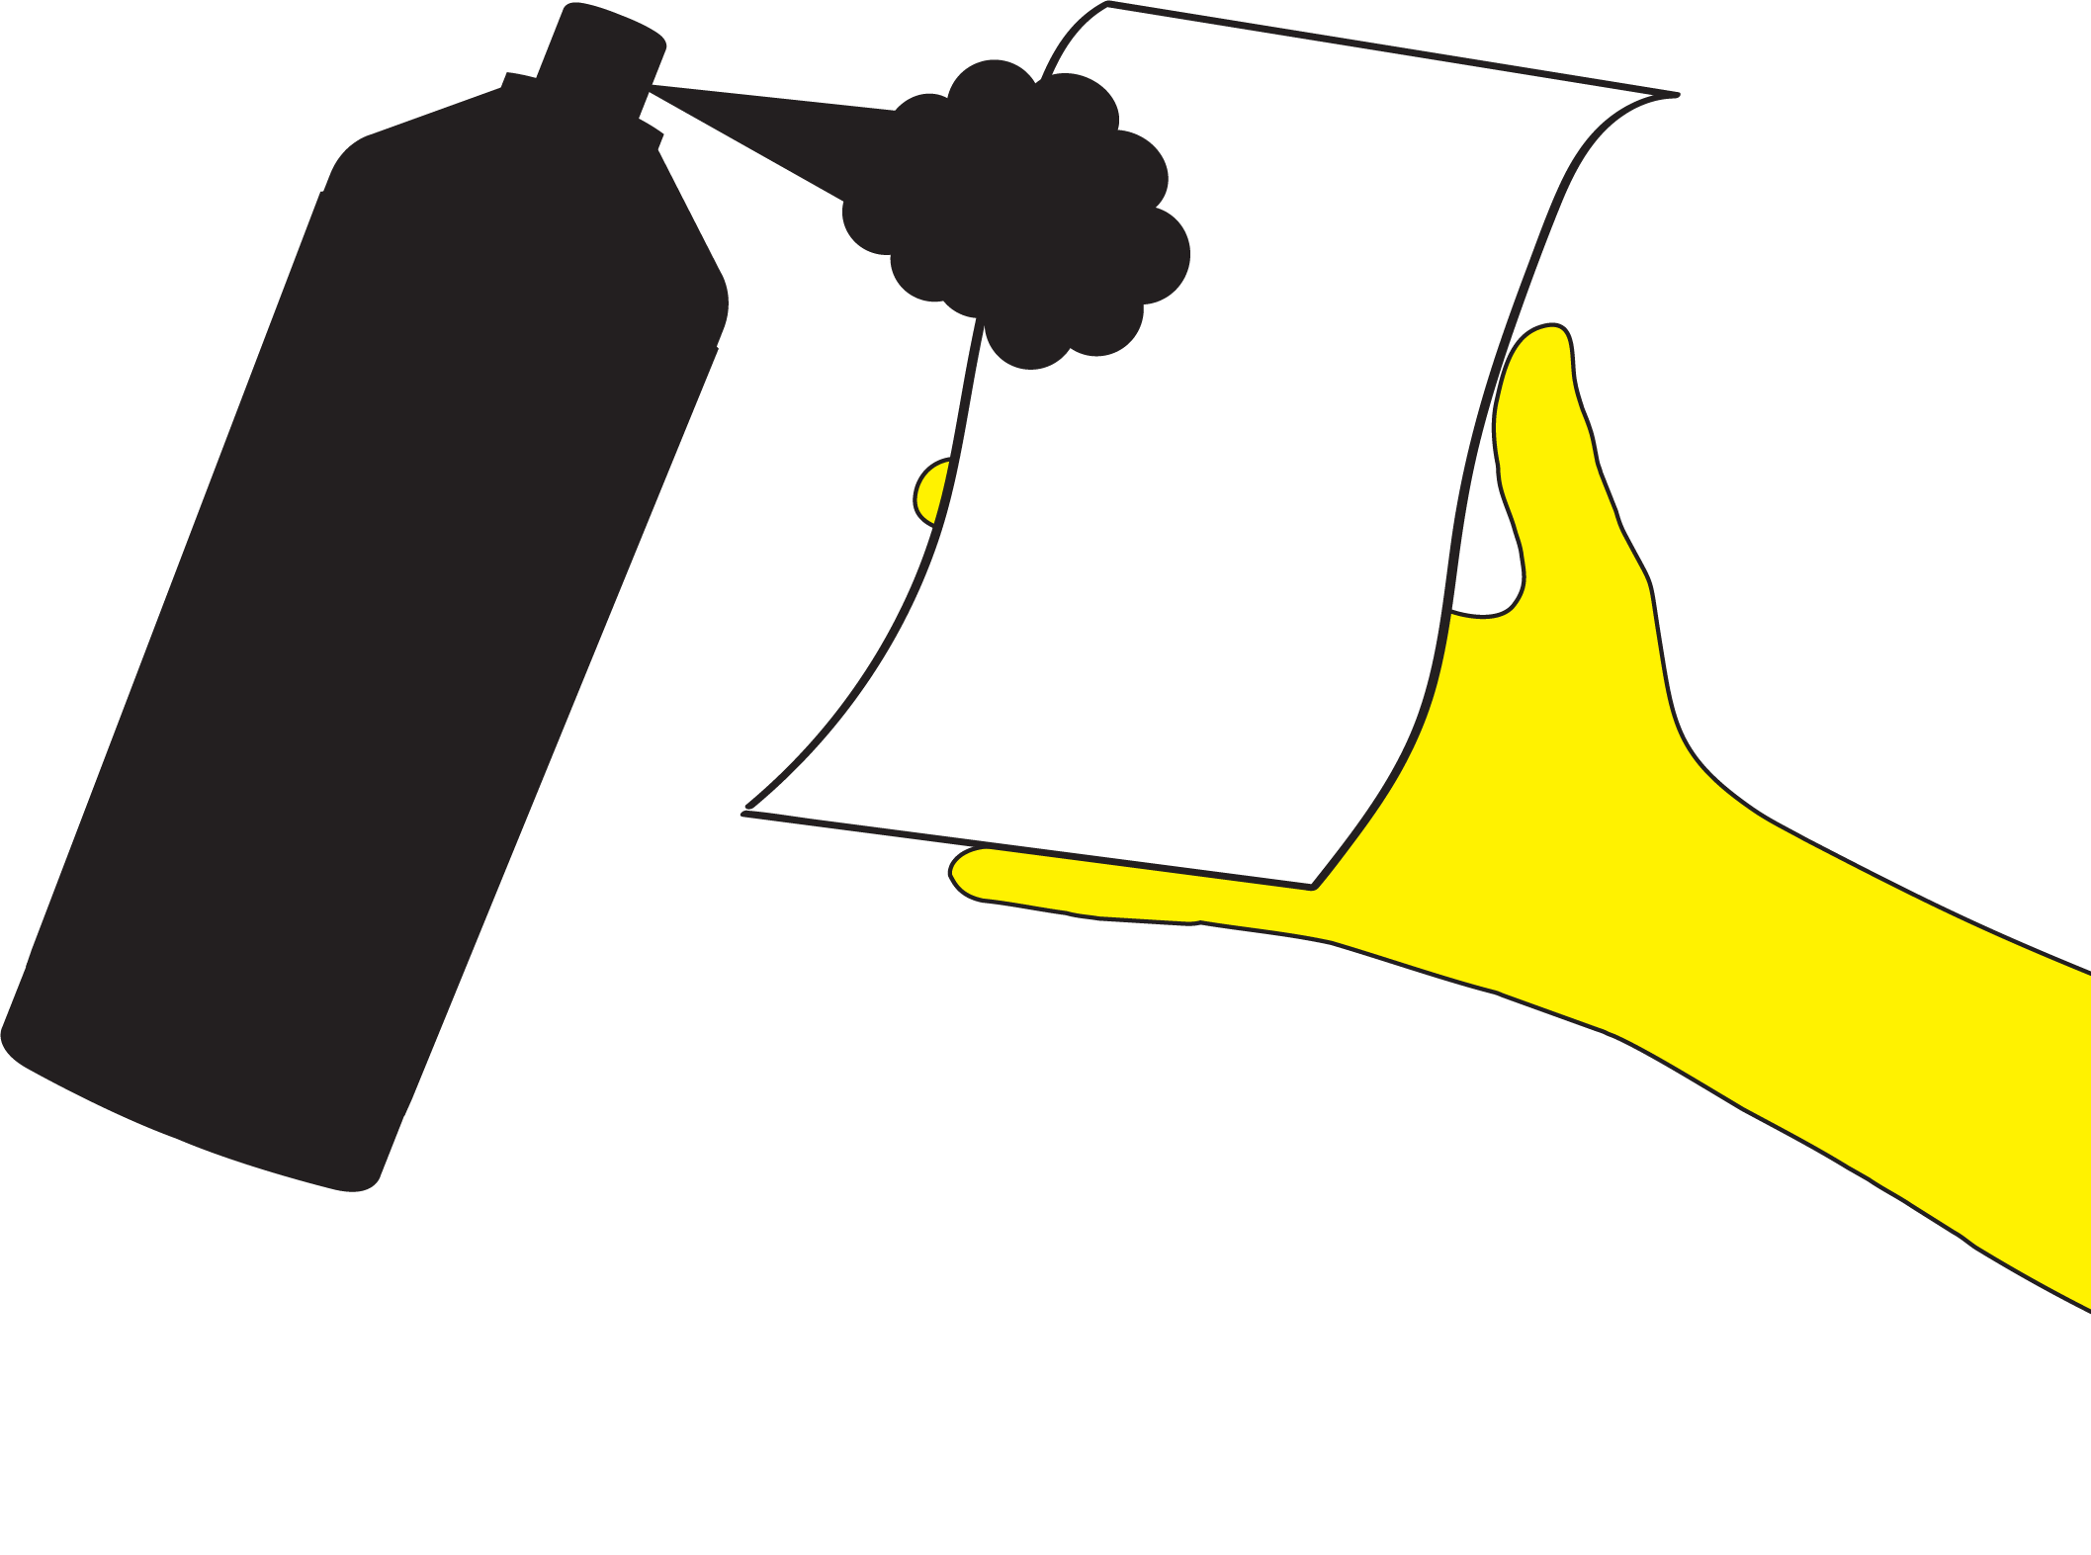
Helpful Hints
Declutter your home
Clean yourself out of a room
Clean from top to bottom
Wipe down walls and areas along the floor five feet around the object you are cleaning
Remove and wash curtains and mini-blinds before washing the windows
When using aerosols or sprays, spray directly onto the cloth
Notes:
Some additional hints for cleaning:
Declutter your home.
Clean yourself out of a room by starting at the furthest point within the room and work your way to the doorway.
Clean from top to bottom in every room.
Wipe down walls and areas along the floor up to five feet in either direction of the object you are cleaning in case lead dust has blown around.
Remove and wash curtains and mini-blinds before you wash the windows.
If using aerosols or sprays, spray onto the cloth rather than directly onto furniture to avoid blowing lead dust around.

Slide 34

Helpful Hints
Wash toys, bottles, pacifiers and stuffed animals regularly
Keep children from chewing painted areas or old painted toys
Regularly check for paint chips or dust
Clean faucet screens
Notes:
Other things to keep in mind:
Wash toys, bottles, pacifiers and stuffed animals regularly.
Keep children from chewing painted areas or old painted toys.
Regularly check for paint chips or dust – if you see some, remove carefully with a damp paper towel and discard in the trash, then wipe the surface clean with a wet paper towel. If renting a house or apartment, notify the landlord of any cracked or peeling paint.
Clean faucet screens (also known as an aerator) regularly by unscrewing it from the bottom of the faucet and run water through the screen (holding it right side up and upside down). Lead particulate and sediment can build up behind faucet aerators and be a potential source of exposure.

Slide 35
What are some lead dust traps in the home?
Notes:
V. Conclusion
During today’s session, we focused on recommended cleaning techniques to reduce potential exposure to lead in our homes. Let us do a quick review of the information we covered.
What are some lead dust traps in the home? Instructor Note: Some possible answers may include windows, doors, floors, air duct covers, stairways, toys, pacifiers, stuffed animals, baby bottles, etc.

Slide 36

Review
Match each lead dust trap with recommended cleaning technique
A cleaning technique can be matched to more than one lead dust trap since the same technique is recommended for cleaning more than one area in the home
Notes:
Turn your Worksheet to the side labeled Lead Dust Cleaning Techniques. Work with the person sitting next to you to match each lead dust trap with recommended cleaning technique. A cleaning technique can be matched to more than one lead dust trap since the same technique is recommended for cleaning more than one area in the home. Instructor Note: Allow participants a few minutes to complete the matching exercise and then review answers with the whole group. Answers can be found upside down under the Recommended Cleaning Technique column.

Slide 37
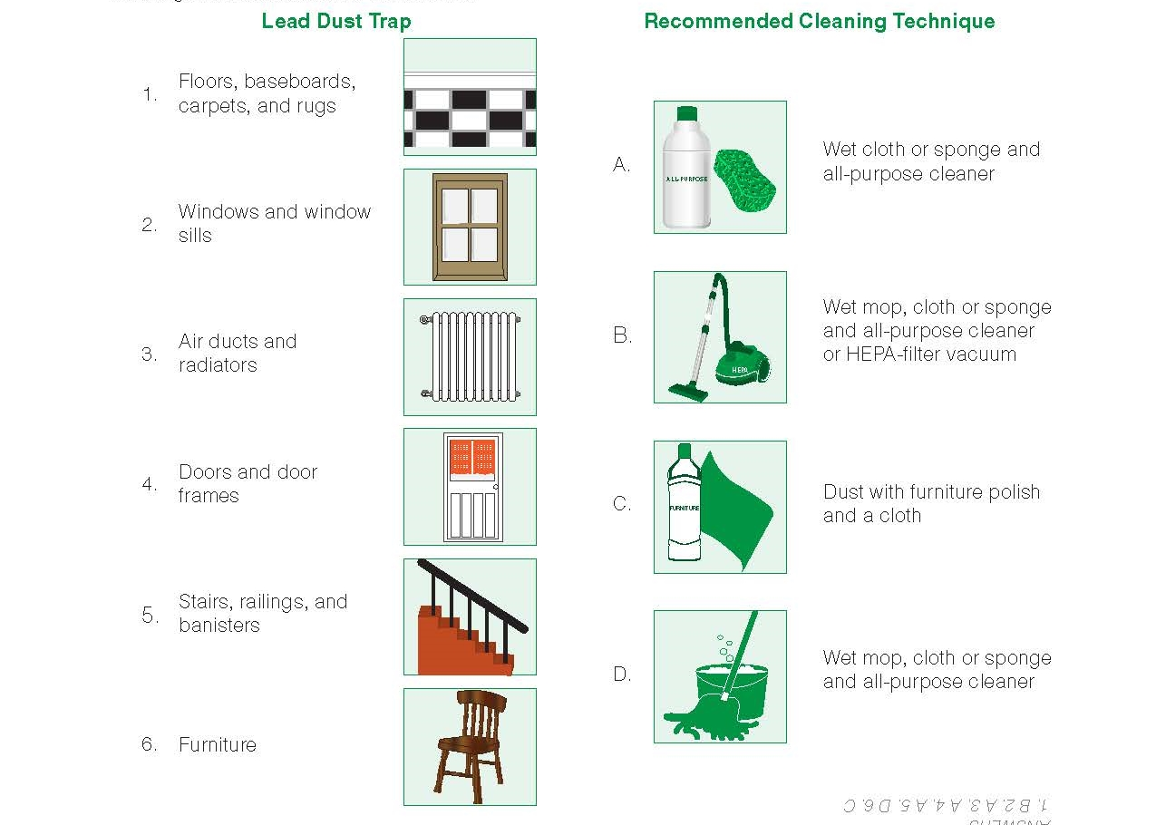
Check Your Answers
Notes:
ANIMATED SLIDE – multiple clicks show answers
B
A
A
A
D
C

Slide 38
Helpful Cleaning Hints
After cleaning your home using the recommended cleaning techniques, what should you do to avoid re-contaminating the area(s) you just cleaned? Select all that apply.
  Wash hands and cleaning supplies in a sink (or areas) that preferably is not used for food preparation.
  Wash the sink itself after washing your cleaning supplies, so that lead dust does not remain in the sink.
  Shower and hair when you finish cleaning.
  Wipe shoes off after cleaning to avoid tracking lead dust around your home.
Notes:
ANIMATED SLIDE – multiple clicks show answers
Look at the Helpful Hints section at the bottom of your Worksheet to finish our review. Instructor Note: Go through the Helpful Hints questions together.
1. After cleaning your home using the recommended cleaning techniques, what should you do to avoid re-contaminating the area(s) you just cleaned? Select all that apply.
Wash hands and cleaning supplies in a sink (or area) that preferably is not used for food preparation.
Wash the sink itself after washing your cleaning supplies so that lead dust does not remain in the sink.
Shower and wash hair when you finish cleaning.
Wipe shoes off after cleaning to avoid tracking lead dust around your home.
Instructor Note: All answers are correct.

Slide 39
Helpful Cleaning Hints
True or False – I should remove and wash curtains and mini-blinds AFTER I wash the windows.
True or False – Many items in my home are potential lead dust traps and clutter could prevent me from effectively cleaning my home.
False
True
Notes:
ANIMATED SLIDE – multiple clicks required (each click will reveal another correct answer).
2. True or False – I should remove and wash curtains and mini-blinds AFTER I wash the windows. Instructor Note: False, do this BEFORE washing the windows.
3. True or False - Many items in my home are potential lead dust traps, and clutter could prevent me from effectively cleaning my home. Instructor Note: True, it is easier to clean when a home is not cluttered.

Slide 40
What new cleaning techniques will you start using in your home?
Notes:
What are new cleaning techniques you will start using in your home? Use the box at the bottom of your Worksheet to write down an answer. Instructor Note: If you have time, have a few participants share what they wrote down.
Possible answers may include:
Cleaning windows, doors, floors, stairs and furniture once a week.
Using a wet or damp cloth, sponge or mop.
Washing children's bottles, toys, pacifiers and stuffed animals regularly.
Does anyone have any questions about today’s topic?

Slide 41
National Lead Information Center
1 (800) 424-LEAD [5323]
Provides the public and professionals with information about lead, lead hazards and prevention
Ask an Information Specialist questions about lead
Monday to Friday, 8:00 am to 6:00 pm ET (except federal holidays)
Hearing- or speech-challenged individuals may access this number through TTY by calling the Federal Relay Service at 1-800-877-8339
Notes:
If you would like more information about cleaning lead dust, contact the National Lead Information Center (NLIC) at 1-800-424-LEAD, or your local health department or clinic.
Instructor Note: Participants can find this number on both the Worksheet and Key Messages.

Slide 42
Thank You!
Module 2: Recommended Cleaning Techniques take-home resources include, the:
Worksheet;
Key messages; and
Kids activity sheet.
Notes:
Thank you for participating in this session. Here is the Module 2 Kids Activity Sheet for you to take home. The Kids Activity Sheet has several activities that teach children about what we learned today. Instructor Note: Give each participant a copy of the Module 2 Kids Activity Sheet.

