Slide 1
DELETE THIS SLIDE PRIOR TO PRESENTATION
This PowerPoint serves as a template presentation which introduces topics related to air quality and is part of a suite of presentations provided by the EPA for the Megacities program.
See speaker notes for an additional description of slide content. Slides should be edited or added to as necessary for your particular needs. Slides with highlighted yellow text require the addition of specific context and information for your city.

Slide 2
Introduction to Air Quality Management

Slide 3
Overview
1. Air Quality Management Planning
2. Legislation and Regulations
3. Mitigation Options

Slide 4
Section 1: Air Quality Management Planning
1. Air Quality Management Planning
2. Legislation and Regulations
3. Mitigation Options

Slide 5
Megacities Framework: Integrated Air Quality Model
1. Gather Available Air Quality Data and Information
6. Implement Enhanced Data
Collection Capacity
2. Assess Current Situation: Identify Key Sources and Hotspots of Exposure
5. Enhance Data Collection Capacity to Evaluate Progress on Emission Mitigation Actions
3. Conduct Analysis of New Emissions Control Measures to Prioritize Actions
4. Take Action:
Legal
Policy
Technologies
Hierarchy of Actions
Legal – What are the gaps?
Policy – What actions can be taken?
Technologies – What control and monitoring technologies are needed?
Source Categories for Best Practices
Point sources (including energy)
Mobile sources
Area sources
Notes:
This slide demonstrates the integrated air quality model that is the backbone of the Megacities partnership.
The general premise is that with any amount of air quality information and will to make change, local and national government agencies can begin to make policy updates to improve air quality and therefore improve quality of human life while decreasing air pollution related health impacts.
Gather available air quality data and information.
Assess the current air quality situation, identifying key air pollution sources and hotspots of exposure. This can be done by collecting relevant emissions source, population, and health impact data. Typically, we have done these analyses using US EPA’s environmental benefits mapping and analysis program, called BenMAP-CE, or BenMAP Community Edition.
Conduct analyses of new emissions control measures to prioritize actions, and for example, target sources like large industries or mobile source emissions.
Take action, which can be legal, policy-specific, or change to technology.
Enhance data collection capacity to further evaluate progress on the emission mitigation actions. This is important because often the action includes improving air quality monitors, expanding the network, improving data collection or publication methods, etc.
Implement enhanced data collection capacity, and begin the process again. The US has gone through this process more than once, beginning in 1970 with the advent of the Clean Air Act. Other developing countries have just begun the process and have made it through a few of the steps over four or five years.

Slide 6
Air Quality Management Planning
Public Participation
Public Participation
Air Quality Goal Setting
Air Pollution Control Strategies
Air Quality Monitoring
Impacts of Air Quality
Legislation, Regulation, and Implementation
Air Quality Modeling
Emissions Inventory
Compliance and Enforcement
Human and Environmental Assessment
Air Quality Data
Notes:
To accompany the previous slide, this conceptual model shows the format of air quality management planning:
If we begin in the center, we see that air quality data is the crucial middle point that all other activities are tied to. Air quality data can be collected by monitoring, modeling, and capturing details within emissions inventories.
Then, we take those data to understand the impacts of air quality via human and environmental assessment. These details can be used to set air quality goals, and then determine air pollution control strategies, which may be based on legislation, regulation, and implementation, and then eventually compliance and enforcement.
These details provide additional data to be considered in assessing air quality.
This work all occurs under the overarching umbrella of public participation, as the public is arguably the most significant stakeholder in this work.

Slide 7
Air Quality Management Plan (AQMP)
Comprehensive document describing:
Motivations for air quality management
Qualitative and quantitative findings on the impacts of air pollution
Targeted actions and a path forward for mitigating sources of air pollution
Blueprint for action to attract additional donor support to implement the AQMP

Slide 8
AQMP Development
Review and update emissions and ambient standards
Analyze emissions source contributions
Evaluate air quality monitoring data
Estimate current and projected future health burden of air quality
Establish goals and objectives for the plan
Develop detailed implementation plan

Slide 9
AQMP Framework
Goal
Objective
Activities
Mandatory Responsibilities
Implementation Plan
Participatory Responsibilities
Timeframes
Indicators
Gather Data
Assess Situation
Monitoring and Evaluation
Conduct Analysis

Slide 10
AQMP Best Practices
Legal framework
Create sectoral reduction targets based on emissions source contributions
Cost-effectiveness of measures
Delineation of responsibilities among implementing agencies
Agencies assigned specific duties
Evaluation and assessment of progress
Ganguly, Kurinji, Guttikunda, 2020
Notes:
Legal framework: implement a legal structure to uphold air quality standards, i.e. regulatory standards
Sectoral reduction targets based on source contributions: Set reasonable sectoral reduction targets based on initial observed levels of pollutant emissions from different sources
Cost-effectiveness of measures: using information on the monetary value of benefits and costs of different policies can help in determining which measure to implement
Delineation of responsibilities among implementing agencies: make it clear where responsibilities lie among collaborating agencies
Agencies assigned specific duties
Evaluation and assessment of progress: Make sure that the AQMP is a circular process, always returning to evaluate and assess progress after implementing a new policy

Slide 11
Key Messages
Air quality management is a continuous cycle of development and improvement with a goal of improving public health and the environment
National, regional, and local regulations, along with voluntary and market-based programs, can be effective in achieving significant air pollution reductions
Regional cooperation is critical for controlling air pollution that affects multiple cities and states/provinces
Providing information to the public enables them to play a key role in achieving standards and improving public health
Transparency makes for better public policy

Slide 12
Section 2: Legislation and Regulations
1. Air Quality Management Planning
2. Legislation and Regulations
3. Mitigation Options

Slide 13
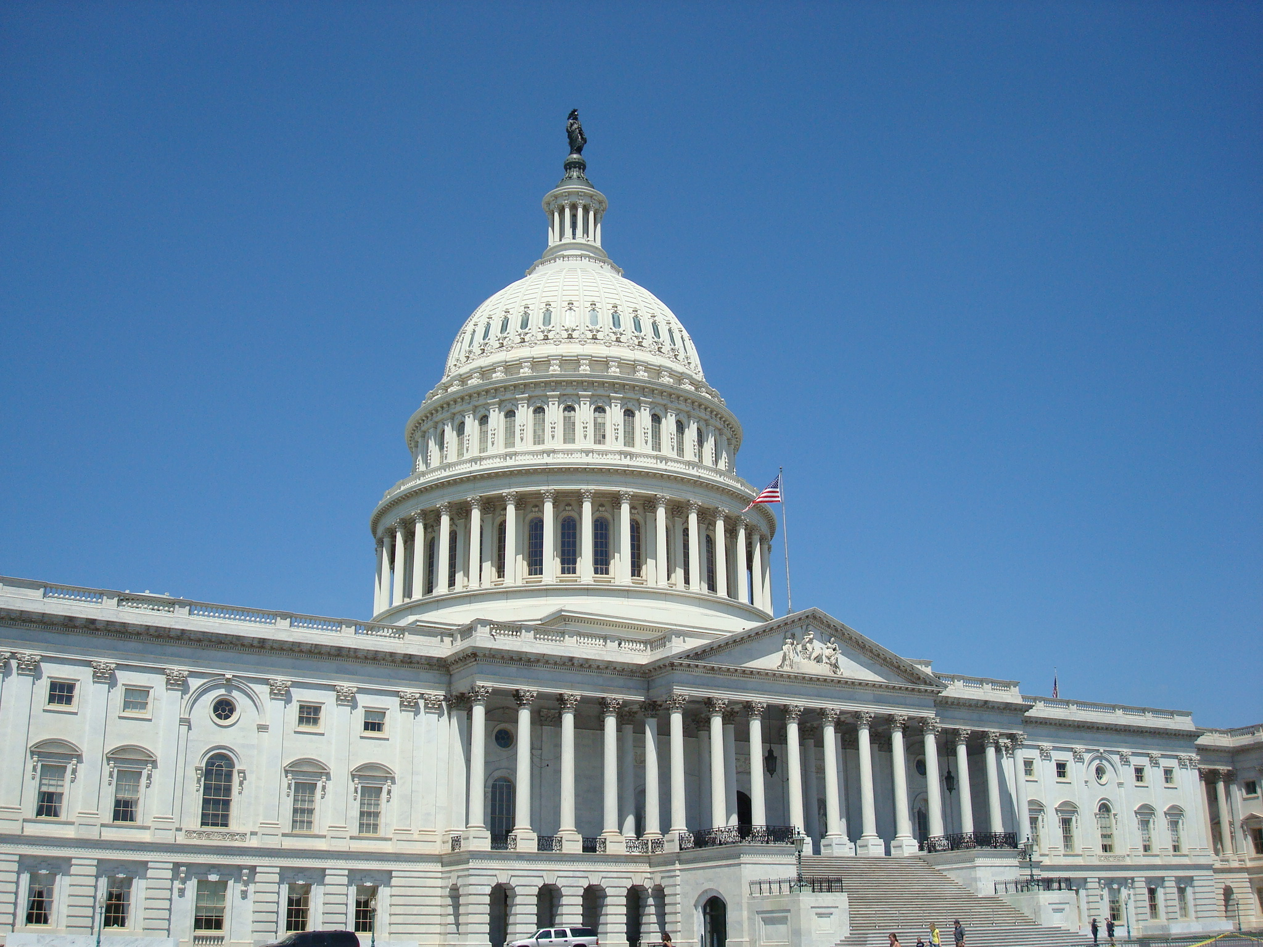
Laws and Regulation Development
Laws make emission standards enforceable.
https://commons.wikimedia.org/wiki/File:The_U.S._Capitol_Building,_Washington,_D.C.jpg
Notes:
The first major component of an air quality management program is laws. On the legal front, the fight for clean air is being implemented through tougher emission standards and a new generation of national laws governing air pollution control.
Therefore, laws and regulations play an important role in an air quality management program. Although the development of the science and technology of air pollution control should continue, laws and regulations will remain one of the most important tools that the air pollution professional may use to confront a persistent problem.

Slide 14
Example: US National Ambient Air Quality Standards (NAAQS)
Pollutant [links to historical tables of NAAQS reviews] |  | Primary/ Secondary | Averaging Time | Level | Form
Carbon Monoxide (CO) (last updated 2011) |  | primary | 8 hours | 9 ppm | Not to be exceeded more than once per year
 |  |  | 1 hour | 35 ppm
Lead (Pb) (last updated 2016) |  | primary and secondary | Rolling 3-month average | 0.15 μg/m³ ⁽¹⁾ | Not to be exceeded
Nitrogen Dioxide (NO₂) (last updated 2018) |  | primary | 1 hour | 100 ppb | 98th percentile of 1-hour daily maximum concentrations, averaged over 3 years
 |  | primary and secondary | 1 year | 53 ppb ⁽²⁾ | Annual Mean
Ozone (O₃) (last updated 2020) |  | primary and secondary | 8 hours | 0.070 ppm ⁽³⁾ | Annual fourth-highest daily maximum 8-hour concentration, averaged over 3 years
Particle Pollution (PM) (last updated 2020) | PM_{2.5} | primary | 1 year | 12.0 μg/m³ | annual mean, averaged over 3 years
 |  | secondary | 1 year | 15.0 μg/m³ | annual mean, averaged over 3 years
 |  | primary and secondary | 24 hours | 35 μg/m³ | 98th percentile, averaged over 3 years
 | PM₁₀ | primary and secondary | 24 hours | 150 μg/m³ | Not to be exceeded more than once per year on average over 3 years
Sulfur Dioxide (SO₂) (last updated 2019) |  | primary | 1 hour | 75 ppb ⁽⁴⁾ | 99th percentile of 1-hour daily maximum concentrations, averaged over 3 years
 |  | secondary | 3 hours | 0.5 ppm | Not to be exceeded more than once per year
https://www.epa.gov/criteria-air-pollutants/naaqs-table

Slide 15
[YOUR COUNTRY] Air Quality Standards
Fill out available information for your country
Pollutant | Annual Standard | Daily Mean (µg/m³) | Maximum Allowable Concentration (µg/m³)
PM_{2.5}
PM₁₀
TSP
O₃
[other pollutants]

Slide 16
[YOUR CITY] Air Quality Standards
Fill out available information for your city
Pollutant | Annual Standard | Daily Mean (µg/m³) | Maximum Allowable Concentration (µg/m³)
PM_{2.5}
PM₁₀
TSP
O₃
[other pollutants]

Slide 17
WHO International Air Quality Guidelines (2021)
Pollutant​ | Averaging Time | Interim Targets (µg/m³​) | Interim Target |  |  | Air Quality Guideline (µg/m³​)
Pollutant​ | Averaging Time | 1 | 2 | 3​ | 4
PM_{2.5}​ | Annual | 35 | 25 | 15 | 10 | 5
 | 24-hour | 75 | 50 | 37.5 | 25 | 15
PM₁₀​ | Annual | 70 | 50 | 30 | 20 | 15
 | 24-hour | 150 | 100 | 75 | 50 | 45
O₃​ | Peak season | 100 | 70 | - | - | 60
 | 8-hour | 160 | 120 | - | - | 100
By reducing air pollution, we reduce burden of disease from stroke, heart disease, lung cancer, and respiratory diseases like asthma
WHO, Air Quality Guidelines – Updated 2021.
Notes:
Note: This data is for 2021, please update figure in following years. These guidelines provide a roadmap towards setting standards if your country or city does not have any, or if you are seeking to upgrade standards to better protect public health.

Slide 18
[YOUR CITY] Major Environmental Policies
Add a timeline of environmental regulation for your city
Example: Madhya Pradesh
The Air (Prevention & Control of Pollution) Act, 1981​
The Environment (Protection) Act, 1986​
Environmental Impact Assessment Notification, 2006, 2009​
National Environmental Policy, 2006​
Fly Ash Management Rule, 2008​
Ambient Air Quality Standard , 1982, 1995, 2009​
The Commission for Air Quality Management in National Capital Region and Adjoining Areas Ordinance, 2020​
Policy on Fuel Quality—Bharat stage VI fuel, and Bharat stage VI Vehicle Emission Standard, 2020
Policy on Electric Vehicles (Delhi, Karnataka, AP)​
Clean Coal Policy (Coal gasification, Coal Beneficiation, Super Critical Boiler Policy, etc.)

Slide 19
[YOUR CITY]: Milestones of AQM
Can include here any past efforts to address air quality management in your city
Example: Ghana
Milestone | Collaborators
AQM in Ghana (Accra, Tema, Kumasi, Takoradi, Tarkwa) | World Bank, GERMP, 1997
National Ambient Air Quality Guidelines | EPA, 2000
Baseline Roadside, Soil, Air Quality Survey | EPA, 2002
Lead (Pb) in soil, air, blood | UNEP, 2002/2006
Air Quality Capacity Building Project | USEPA, 2005
Vehicular Emission Inventory | DANIDA TSP II, 2005
Urban Transport Project, AQM Programme | World Bank, GEF, 2009-2015
Air Pollution and Associated Health Studies | GHS, 2010
MoT Vehicle Testing Centres | DVLA, 2010

Slide 20
Importance of Regional and Intergovernmental Cooperation
Air pollution crosses many boundaries
Ozone, particulates, and persistent pollutants
Causes episodic problems
Increases background concentrations
Notes:
Air pollutants can travel hundreds of kilometers from their point of emission to affect air quality and ecosystems far away from their source.
Travels with the wind currents across regional borders, and trans-oceanic/trans continental transport
A number of toxic air pollutants persist in the environment and concentrate through the food web and have been found in fatty tissues of polar bears and other Arctic animals thousands of miles from any possible source.
Lead and other trace metals have been measured in the air and rainfall at remote locations over the Atlantic and Pacific Oceans, great distances from likely sources.

Slide 21
Section 3: Mitigation Options
1. Air Quality Management Planning
2. Legislation and Regulations
3. Mitigation Options

Slide 22
Mitigation Option Examples
Vehicles
Vehicle emission standards and inspection program
Vehicle import limits or taxes, especially used vehicles
Fuels
Clean diesel standards
Low sulphur fuel
Fuel import standards
Transport systems
Safe walking and cycling
Public transport systems enhancements
Parking policies
Notes:
From CSE Guidance and UNEP Situational Analysis

Slide 23
Mitigation Options Examples, continued
Small Industrial Sources
Improved compliance for existing industrial standards
Energy Sector
Renewable electricity generation
Genset standards and regulations
Construction Industry
Dust control measures, e.g., water sprinkling
Building materials and debris recycling and disposal
Notes:
From CSE Guidance and UNEP Situational Analysis

Slide 24
Mitigation Options Examples, continued
Open waste burning
Composting and waste sorting strategies
Improve waste collection and ban curb burning
Household fuel burning
Stove replacement
Incentivize cleaner fuels
Notes:
From CSE Guidance and UNEP Situational Analysis

Slide 25
Thank you!

