Slide 1
DELETE THIS SLIDE PRIOR TO PRESENTATION
This PowerPoint serves as a template presentation which introduces topics related to air quality and is part of a suite of presentations provided by the EPA for the Megacities program.
See speaker notes for an additional description of slide content. Slides should be edited or added to as necessary for your particular needs. Slides with highlighted yellow text require the addition of specific context and information for your city.

Slide 2
Air Quality Monitoring and Modeling

Slide 3
Overview
1. Air Quality Monitoring
2. Air Quality Modeling
3. Baseline Assessment

Slide 4
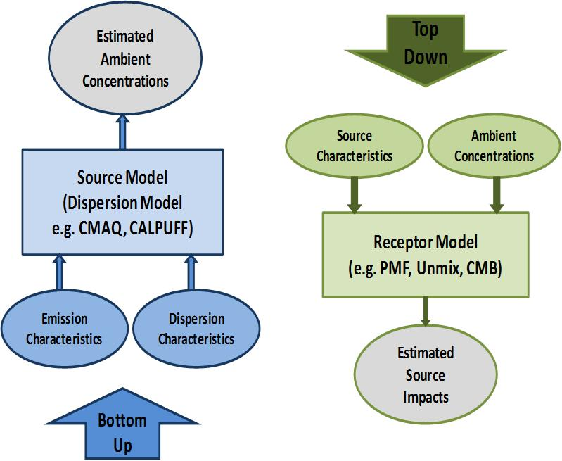
Approaches to Air Quality Characterization
Modeling
Monitoring
Sonoma Technology, Inc.
Notes:
Air quality modeling is a bottom-up approach. This means that we take information about source emissions and bring them together to analyze how those emissions are interacting with one another, as well as meteorological factors, impacting ambient concentrations of pollutants.
Emissions data provide information on pollutants that are being emitted from different sources.
Air quality monitors are part of top-down analysis of air quality. The ambient concentrations are collected, which is at the “top”. Ambient air quality information can then be teased apart in a number of ways, through understanding source characteristics and time activity patterns, and then utilization of a receptor model like US EPA’s PMF or UNMIX models for source apportionment to estimate individual source impacts. This is in comparison with bottom-up approaches, which use emissions and dispersion characteristics in conjunction with dispersion models to estimate ambient pollutant concentrations.
In the US, we have built a bottom up approach, beginning in 1970, using an infrastructure that was already in place for emissions inventories and AQ modeling.
A top down approach, however, will give you more opportunity to act quickly. It is less technically complex and focuses on monitored data and statistical detangling of the sources based on gravimetric sample collection and lab analysis.
Ultimately, you’d like to do both, but our focus is taking action sooner than later.

Slide 5
Section 1: Air Quality Monitoring
1. Air Quality Monitoring
2. Air Quality Modeling
3. Baseline Assessment

Slide 6
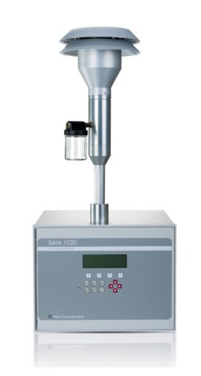
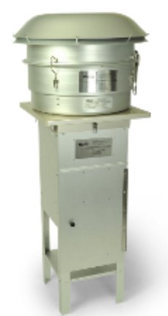
Particulate Matter (PM) Monitoring
Gravimetric sampler
Continuous monitor
Notes:
Gravimetric samplers are capable of sampling at very low detection limits, and take a single integrated sample on a filter. The filter then needs to be analyzed in a laboratory setting. These are useful in measuring PM10 and PM2.5 concentrations during 24-hour time frames.
Continuous monitors can be advantageous in reducing labor and data processing requirements since they do not require any post processing, and report measurements at fine temporal resolution.

Slide 7
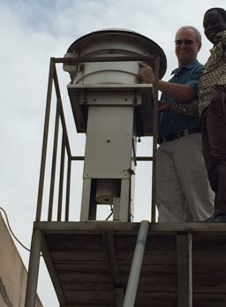
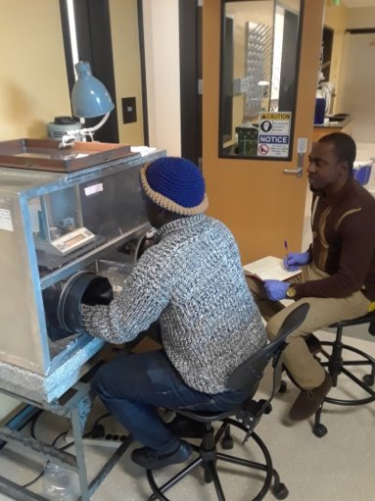
PM Monitoring
Accra, 2016
CU Boulder, 2018
Notes:
The photo on the left shows John Nyante from EPA Ghana showing Dr. Mike Hannigan from CU Boulder a gravimetric PM10 sampler he maintains in Accra, Ghana.
The photo on the right shows John Nyante and Jerry Asumbere, both of EPA Ghana, measuring filters in a glove box in Dr. Hannigan’s lab in Boulder. A controlled environment is critical for the pre- and post-sample weighing of gravimetric filters, to control for the effect of factors such as humidity.

Slide 8
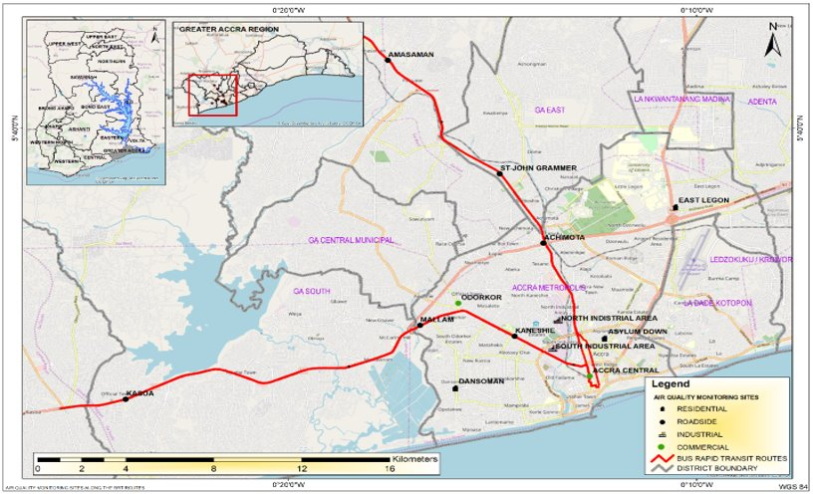
[YOUR CITY]: Monitoring Network
If there is an existing air quality monitoring network, include information or figures here
Example: Accra

Slide 9
Section 2: Air Quality Modeling
1. Air Quality Monitoring
2. Air Quality Modeling
3. Baseline Assessment

Slide 10
Air Quality Modeling Uses
Air quality modeling helps to estimate the relationship between sources of air pollution and their effects on ambient air quality
Identify source contributions
Design effective air quality strategies
Predicts impact from new or proposed emissions sources
Simulates ambient pollutant concentrations under different air quality policy scenarios
Tracks trends
Assesses compliance

Slide 11
Requirements
Air quality models require detailed data inputs:
Emissions information
Emissions inventory
Source characteristics
Location, stack height, source type, exit velocity, release rate
Meteorological conditions
Wind speed, wind direction, temperature, humidity, mixing height
Topography
Receptor locations
Obstructions
Secondary atmospheric chemistry processes

Slide 12
Sources
Point Sources
Area Sources
Mobile Sources
Power or chemical plant stacks
Cook stoves
On-road vehicles
Waste burning
Off-road vehicles
Ships

Slide 13
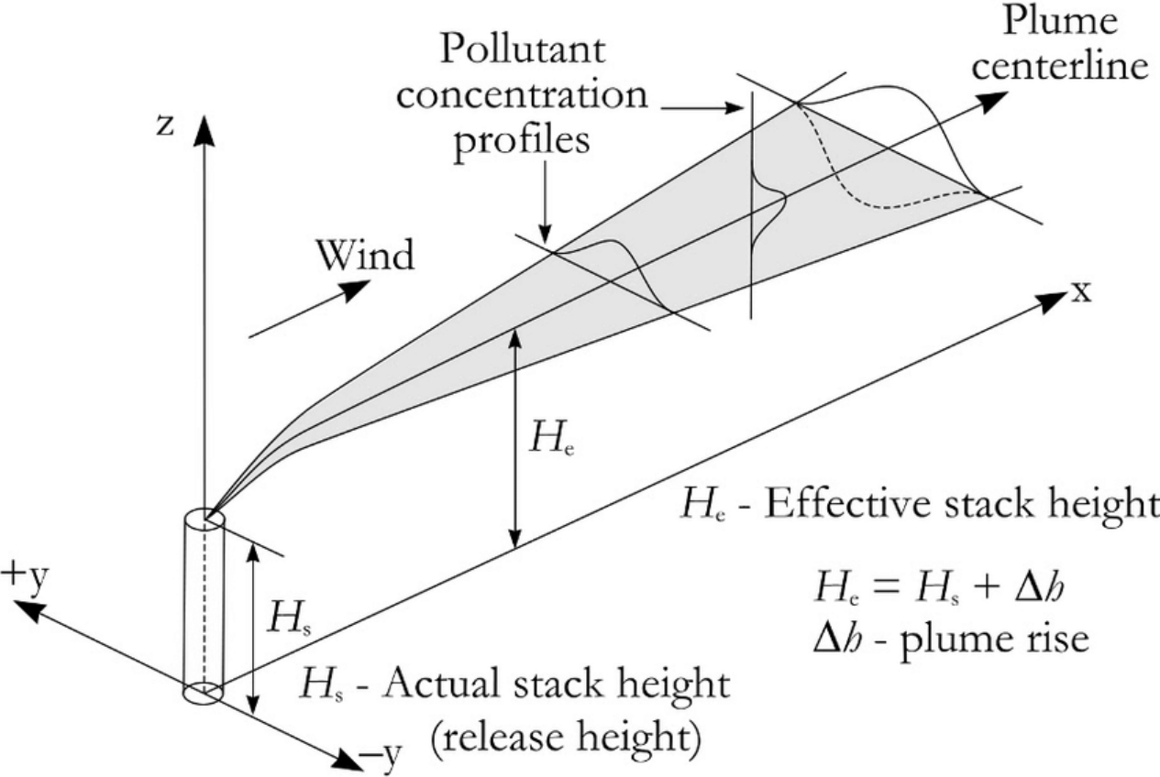
Air Quality Model Types
Box Models
Simplest form of model using flow into and out of an atmospheric “box”
Governed by mass balance equation
Gaussian Dispersion Model
Includes turbulent diffusion, reflection from the ground and inversion layers, elevated source, buoyancy, and multiple sources
Does not account for chemical reactions or change over time
EPA AERMOD
Does not resolve spatial distribution of pollutant; assumes uniform mixing, does not account for time
https://www.researchgate.net/figure/Schematic-figure-of-a-Gaussian-plume-The-effective-stack-height-H-and-the-crosswind-and_fig3_269105054
Notes:
There are a number of types of air quality models that differ in complexity and form. We are starting with the least complex and going forward to more complex models.
Box models are the simplest form of air quality model and are governed by mass balance equations. These models use flow into and out of an atmospheric box, which is described by the area being analyzed, with the atmospheric mixing height at the top and the ground at the bottom of the box. Box models do not resolve the spatial distribution of a pollutant in the box, and assumes uniform mixing within the box. This is most commonly used for a single pollutant.
Gaussian dispersion models are also fairly simple, using Gaussian dispersion equations to determine the movement of an emissions plume. These models allow for turbulent diffusion both horizontally and vertically, and allow for reflection of the plume from both the ground and inversion layers. Gaussian plume models can account for multiple sources, and incorporate plume buoyancy, though do not account for chemical reactions or change over time. A common example of this type of model is the EPA’s AERMOD, which models primary emitted particles and gases, and is most commonly used for mobile sources.
http://elte.prompt.hu/sites/default/files/tananyagok/AtmosphericChemistry/ch10s03.html

Slide 14
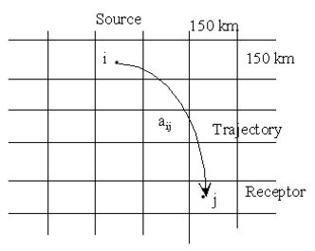
Air Quality Model Types
Source-Receptor Models
Identify and quantify sources of air pollutants at receptor locations
Describes the sensitivity of a receptor element to a source
The receptor may be the average concentration of a pollutant at a specific place and time
The source may be a point, area, or volume source active during a specific time interval in a specific location
Source Receptor Matrix
Notes:
S-R relationship can be linear or nonlinear.
Allows first-order chemical reactions that are linear.
Can accommodate many sources and many receptors.
Matrix of receptor value over source values. Knowing this matrix allows for a given source vector, the resulting receptor vector values can be obtained by a simple matrix-vector multiplication.
Appropriately describes transport and dispersion.

Slide 15
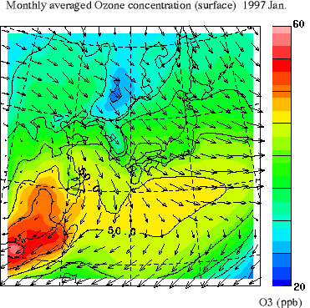
Air Quality Model Types
Eulerian Regional-Scale Dispersion Models
Transport, dispersion, deposition, and
chemical transformation of pollutants
emitted from sources
“One atmosphere,” 3D type models
CMAQ, CAMx
Lagrangian Trajectory Models
Follows pollution plume parcel trajectory
Allows temporal and spatial variation in emissions and meteorology
CALPUFF, HYSPLIT
Lagrangian Trajectory Model
Notes:
Eulerian regional-scale dispersion models are more complex than Gaussian models or box models. They allow for the transport, dispersion, deposition, and chemical transformation of pollutants emitted from different sources, specifically for particles. Eulerian models allow for dispersion of pollutants based on static reference points in the atmosphere, shown as 3 dimensional grids. Eularian models are “one-atmosphere” models, indicating that they are in 3 dimensions and account for the meteorology, atmospheric chemistry, dispersion, and deposition in the atmosphere at one time. These models do a good job of modeling regional pollutants, since they can account for atmospheric chemistry and formation of particles and secondary pollutants over time and space. Common Eularian models include CMAQ and CAMx – the figure on the right shows CMAQ output, showing an ozone concentration surface over 36km x 36km grids.
Lagrangian trajectory models are similar to Eulerian models, but differ with respect to the perspective of atmospheric motion. Lagrangian models follow pollution plume parcel trajectories. They allow for temporal and spatial variation in emissions and meteorology, whereas Eularian models account for one period of time, and need to be re-run at different points in time to account for temporal differences. Common Lagrangian models include CALPUFF and HYSPLIT.

Slide 16
Section 3: Baseline Assessment
1. Air Quality Monitoring
2. Air Quality Modeling
3. Baseline Assessment

Slide 17
Baseline Data
Change in pollutants or change in air quality can be determined through:​
Air quality monitoring over time​
Air quality modeling of changes in emissions over time

Slide 18
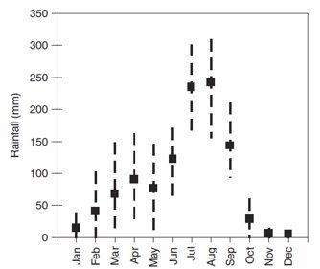
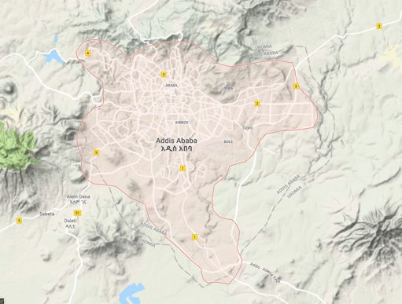
[YOUR CITY]: Meteorology and Geology
Include figures and graphs describing your city’s geography, weather pattern (i.e., rainfall), and other meteorological phenomena that may impact air pollution
Example: Addis Ababa
Etyemezian et al., 2005​

Slide 19
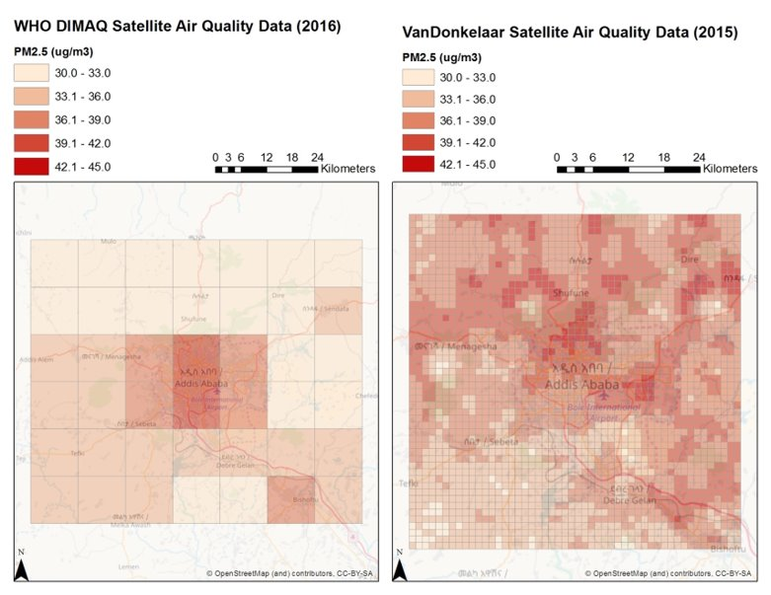
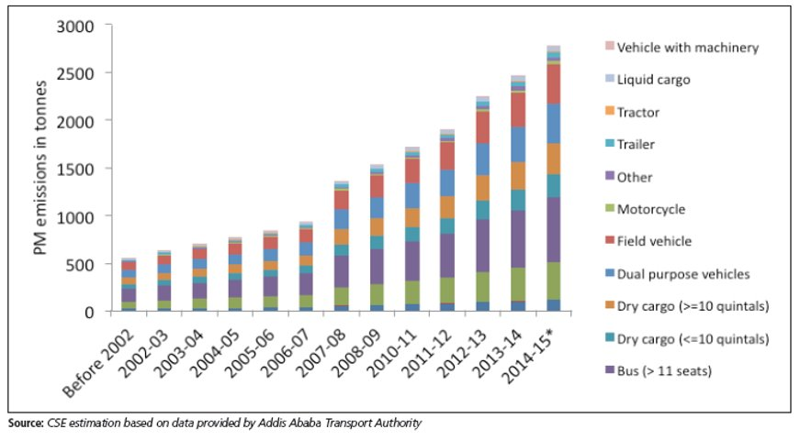
[YOUR CITY]: Pollution Sources and Emissions
Detail main pollutants of focus and their sources in your city, perhaps with related figures
Example: Addis Ababa

Slide 20
[YOUR CITY]: Projecting Growth
In this section, include any information about projected growth (i.e., GDP growth) which can be used to plan for changes in emissions in the future
Example: Addis Ababa
Emissions and Air Quality Projection Assumptions ​
Transport sector: Project emissions and air quality from transport sectors based on growth rate of registered vehicles from 2011-2015​
Source: CSE based on Addis Ababa Transport Authority Data​
Result: 12% annual growth rate​
Fuel Burning: Project emissions and air quality from open burning based on Central Statistical Agency’s population projections for 2022 and 2027​
Source: Central Statistical Agency population data​
Result: 12% annual growth rate to 2022, 11% from 2023 to 2027​
Other: Project the remaining PM2.5 by percent GDP growth from 2011-2016​
Source: World Bank​
Result: 10% annual growth rate​

Slide 21
[YOUR CITY]: Pollution Source Description
Example of pollution source description, from Madhya Pradesh:
INDUSTRIAL AIR POLLUTION
17 categories of highly polluting industries ​
Large number of Air Polluting SSI units ​
2,10,000 MW Coal based power plants (Majority having no emission control of SO₂, NOx) – Sulphate and Nitrate became part of PM_{2.5} as evident from SA studies​
90 million tonnes Iron & Steel plants – toxic emission from coke oven plants, sinter and SMS plants
16 large oil refineries emitting VOCs and other toxic pollutants ​
Large number of DG sets in urban areas​
More than 3 lakhs brick kilns, mostly located in ganga basin creating serious air pollution problem in northern India​
Air polluting due to burning of waste at MSW dumping sites ​
Industrial waste (plastic , Waste rubber etc.) are burnt illegally in many part of the country

Slide 22
Key Considerations
What do you know about likely future pollutant emissions?​
Are there plans or needs for use of new electric generating facilities or the use of diesel generators?
What are the trends in car ownership, fuel use, and vehicle type (e.g., more Euro 5 and 6 vehicles now or in the future)?​
What are other trends in population and GDP which may drive industrial and household sector emissions?

Slide 23
Thank you!

